Slide 1
Take-away Food Delivery System
Application Engineer & Dev
Team ParkDriver
Fang Guo 001326849
Bochao Wang 001087950
Kai Zhang 001306003

Slide 2
CONTENT
01
02
03
04
05
Problem Statement
Use Cases & Screenshots
Solution
Approach
Object Model

Slide 3
Part One
Problem Statement

Slide 4
Problem Statement
In the US, many restaurants have their own take-away service, or use a delivery service like UberEATS. However, these take-away services have some problems. For example, customers cannot see the evaluation of restaurant and foods easily, or it is difficult for customers to track the delivery schedule of the takeaway. The problems can be roughly divided into following three parts.

Slide 5
Part Two
Solution

Slide 6
Solution
Order Part
Provide evaluation and other details of the restaurant and foods.
Order Detail Part
Provide status and other details about the order.
Evaluation Part
Quick evaluation of the order.
01
02
03

Slide 7
Part Three
Approach

Slide 8
Approach
The purpose of this project is to build a take-away food delivery system which combines the restaurant, customer and delivery service all together.
By doing so, the whole take-away process can be more convenient and mature, customers can see the evaluation of restaurant and foods easily, and it is easy for customers to track the delivery schedule of the takeaway.

Slide 9
Approach
1
2
3
4
Request Transfer & Information Queue
OOD pattern
Design Module
Implementation Process
Inheritance
Polymorphism
Abstraction
Encapsulation
The take-away model is a project development architecture, the development process is developed by designing a series of stages.
Based on transferring the request, the customer order process, the restaurant verify process, the delivery process will be realized. In order to improve the efficiency of information transmission, every enterprises maintains its own information queue.
Top-down design and Bottom-up implementation, reduce the development difficulty through structured processes.

Slide 10
Part Four
Object Model

Slide 11
Object Model
System
Network
Enterprise
In our system, we can create multiple networks as different cities, such as Boston or New York.
Under each Enterprise Directory, we can create multiple enterprises in each particular type.
Network
Enterprise Directory
Enterprise
Enterprise Directory
Organization
For each Network area, there exist three enterprises list, which is enterpriseList, deliveryServiceList, restaurantList.
Organization
In each enterprise, there exist two roles, the manager role and the employee role, for each role, they will have their own responsibility range.

Slide 12
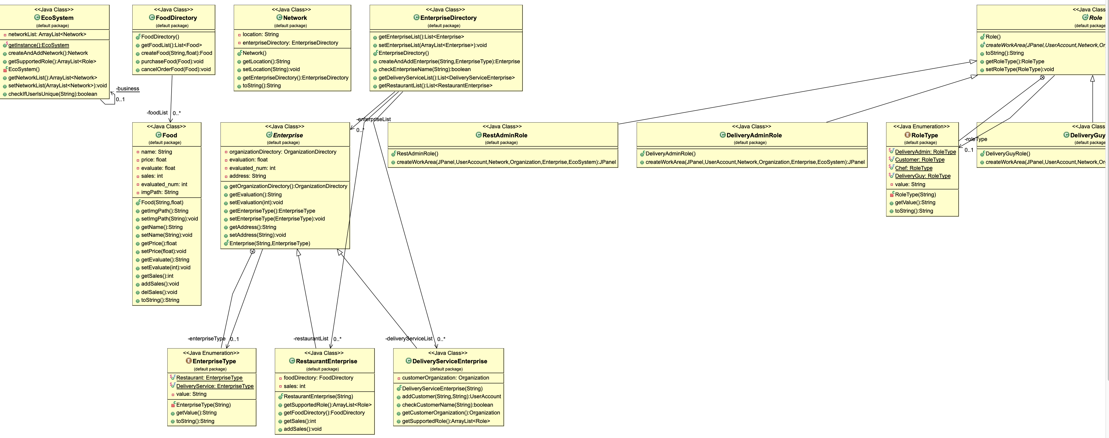
Object Model

Slide 13
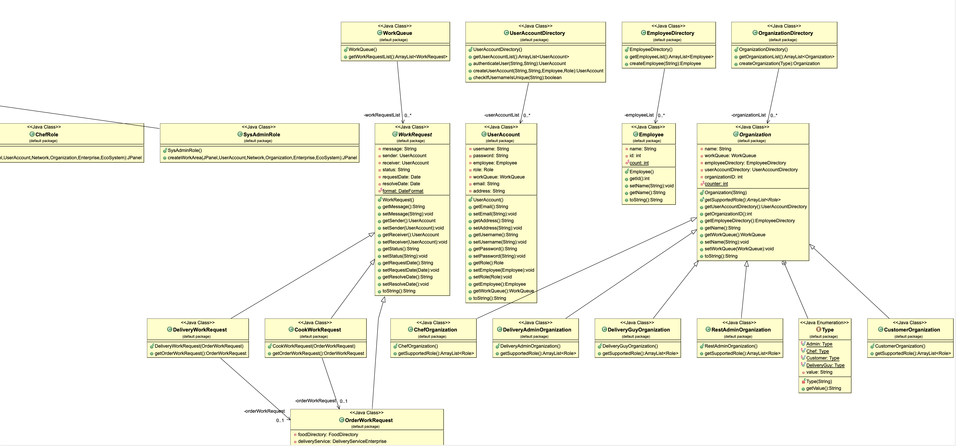
Object Model

Slide 14
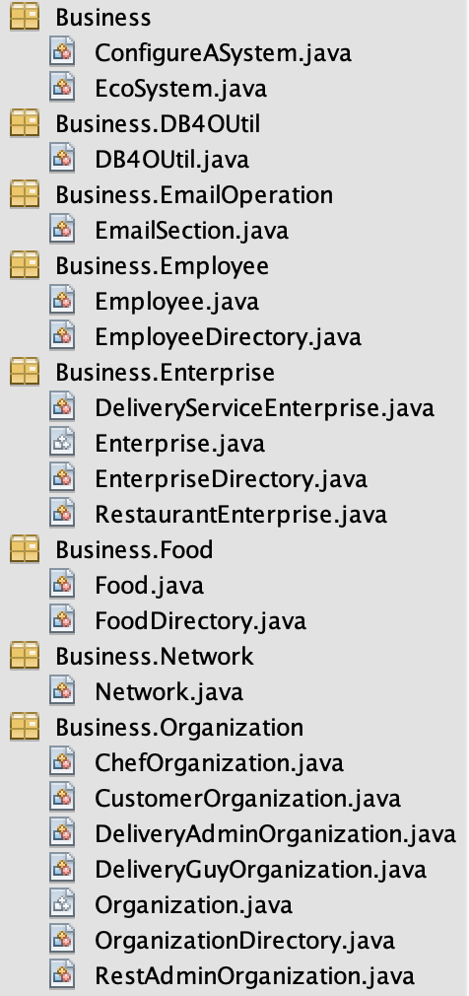
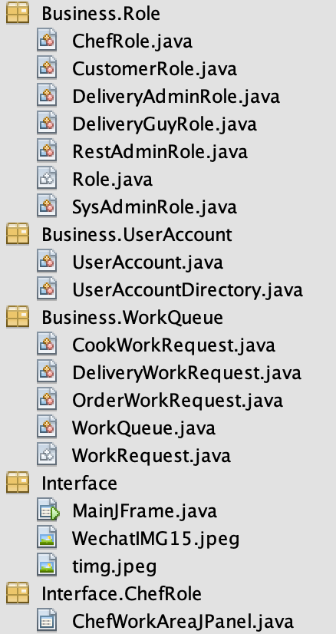
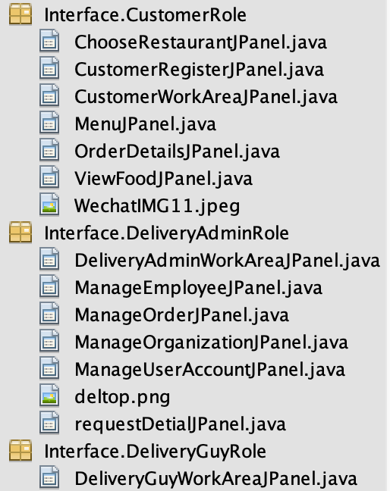
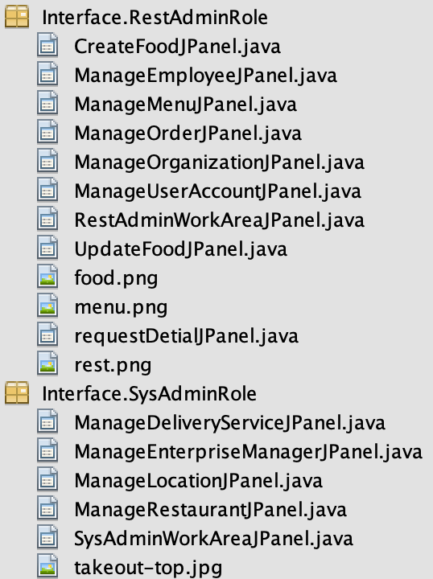

Slide 15
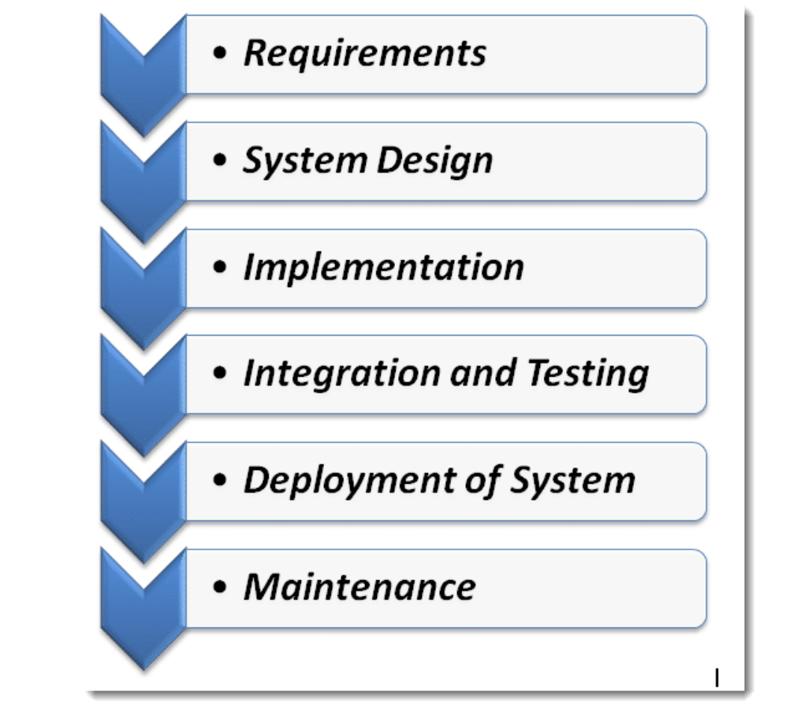
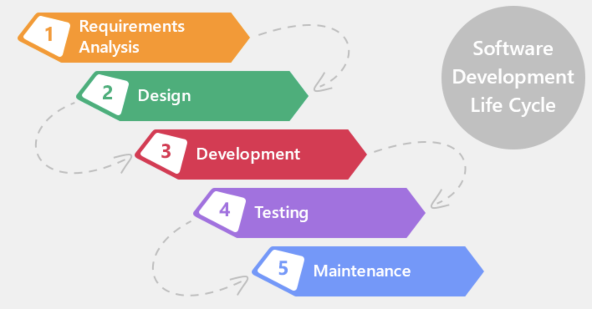
Object Model
Software Development Life Cycle
Waterfall Model

Slide 16
Part Five
Use Cases & Screenshots

Slide 17
System Admin
Login as an default admin role;
Create network locations;
Create restaurant and delivery service;
Create manager account for Enterprises;
View the account information for different manager in different enterprise;

Slide 18
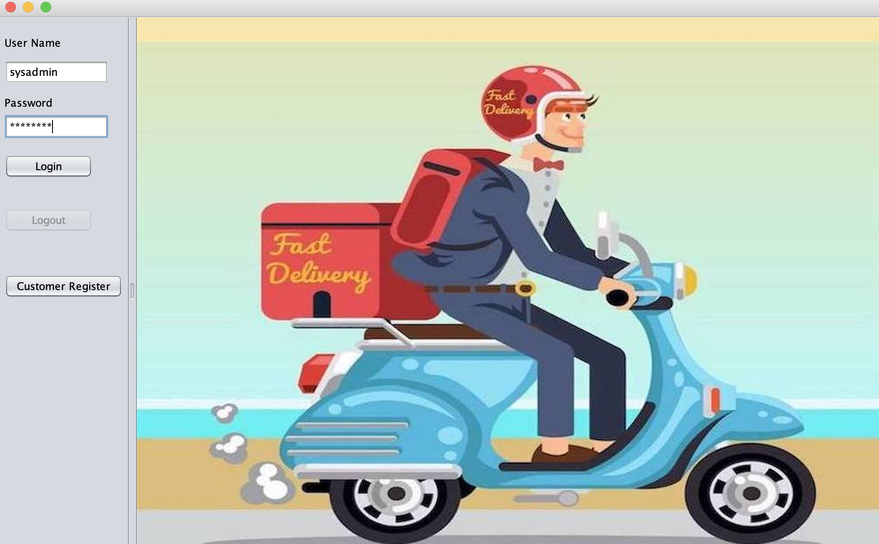

Slide 19
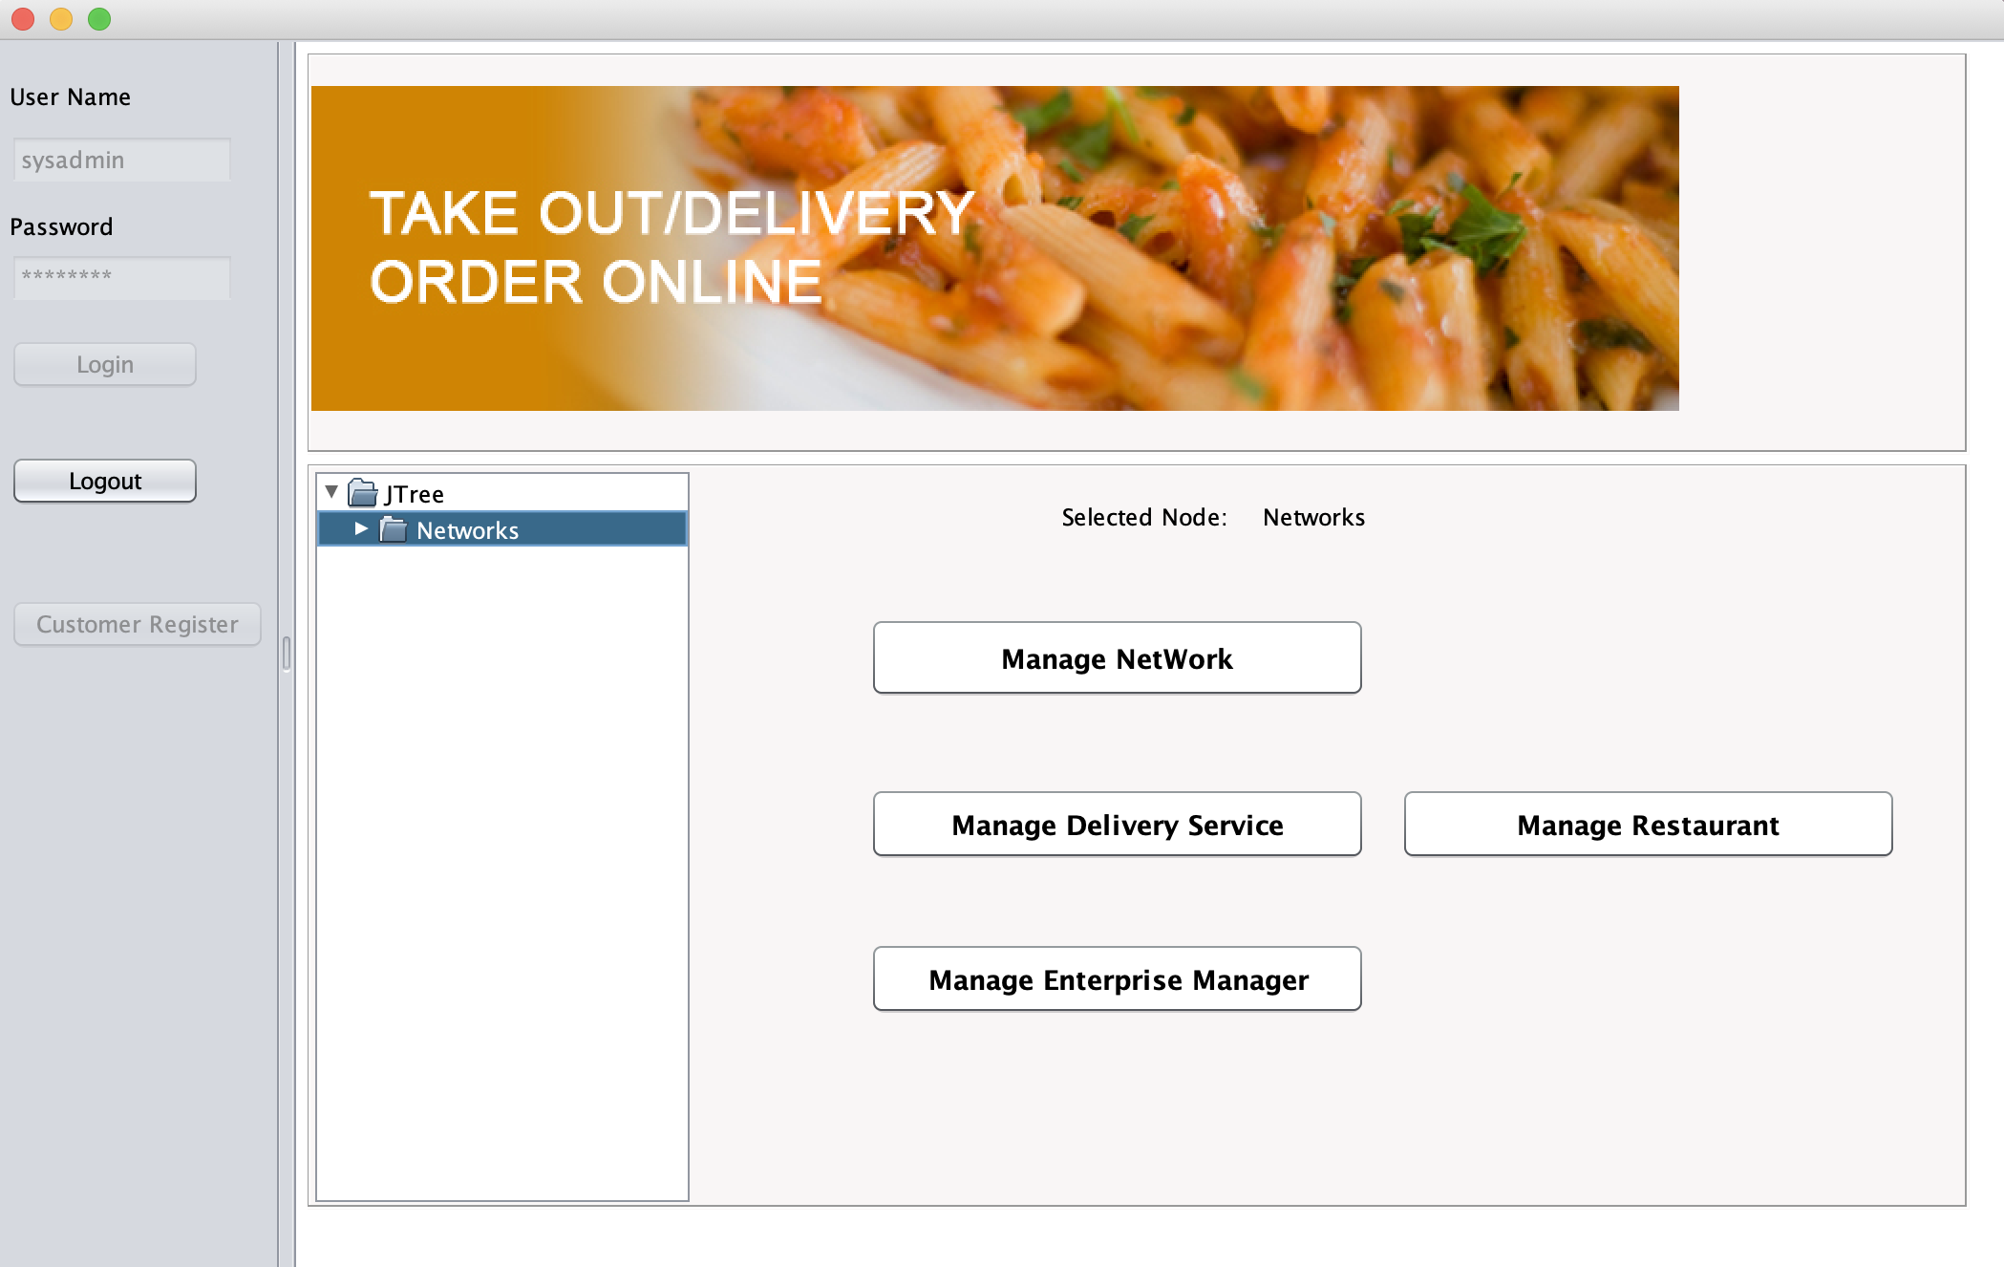

Slide 20
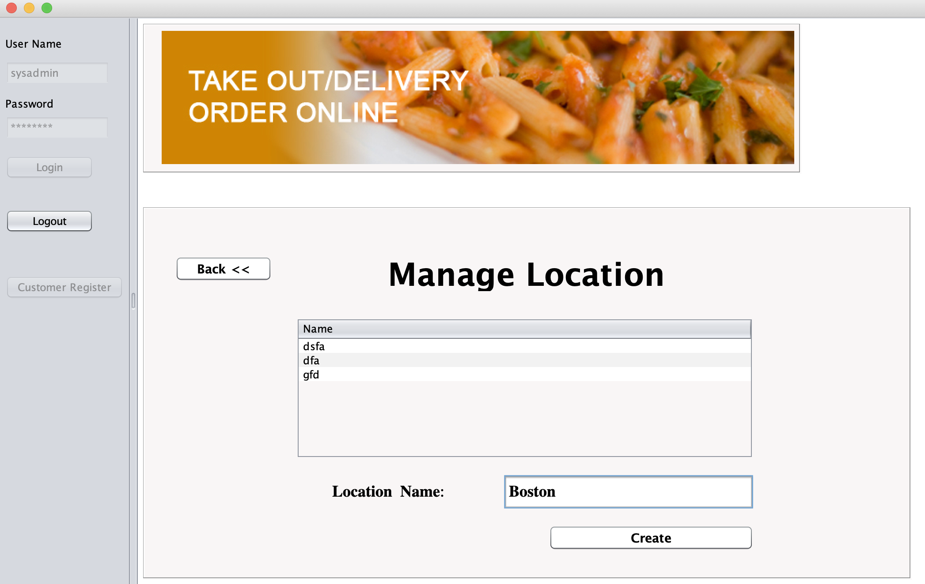

Slide 21
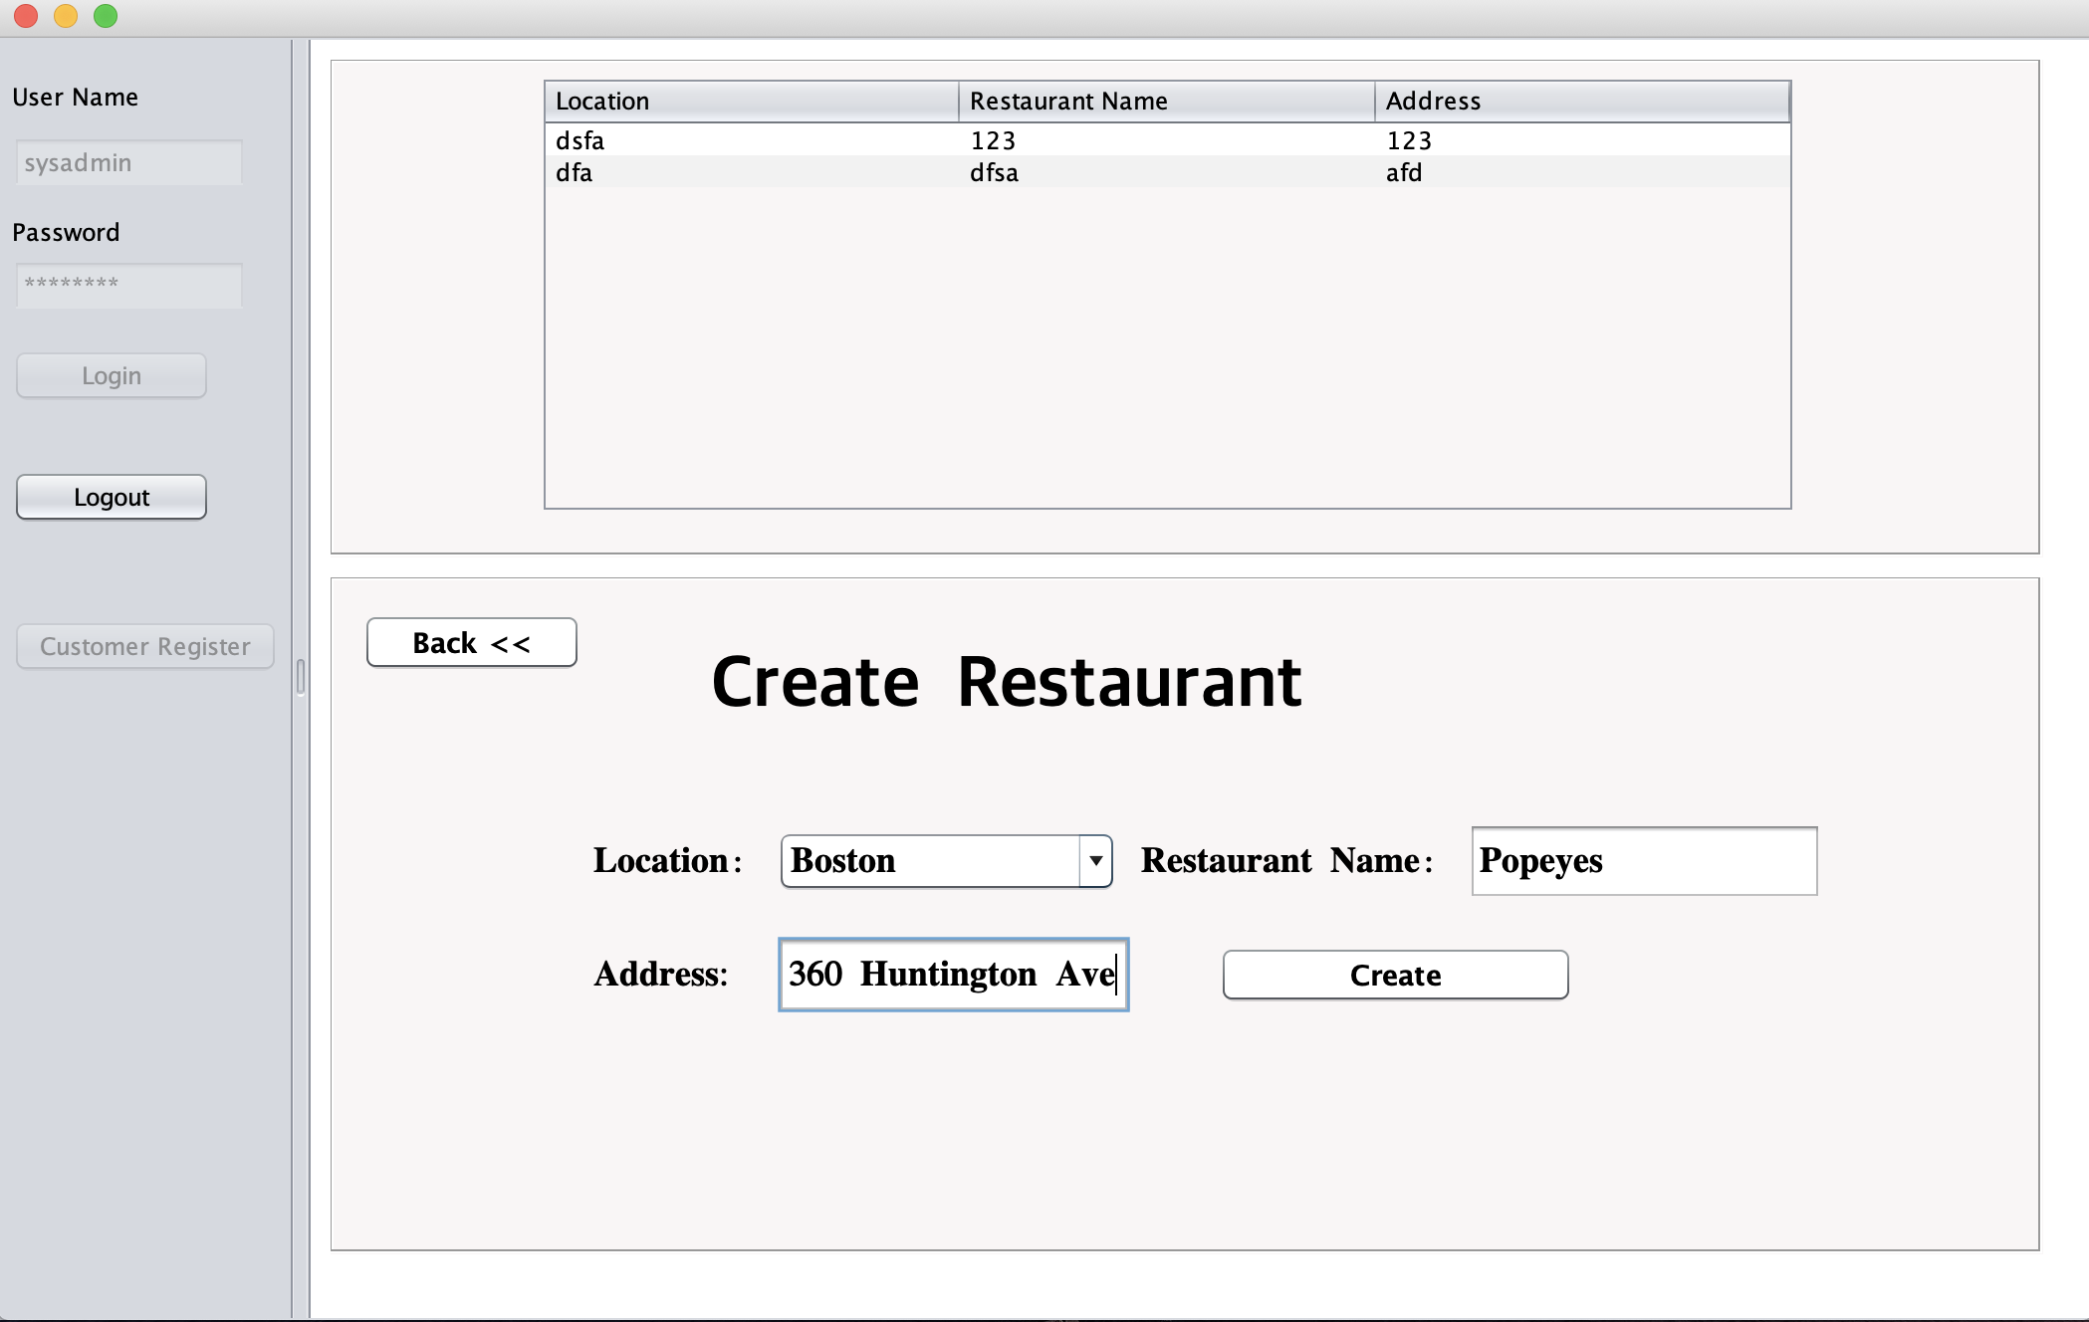

Slide 22
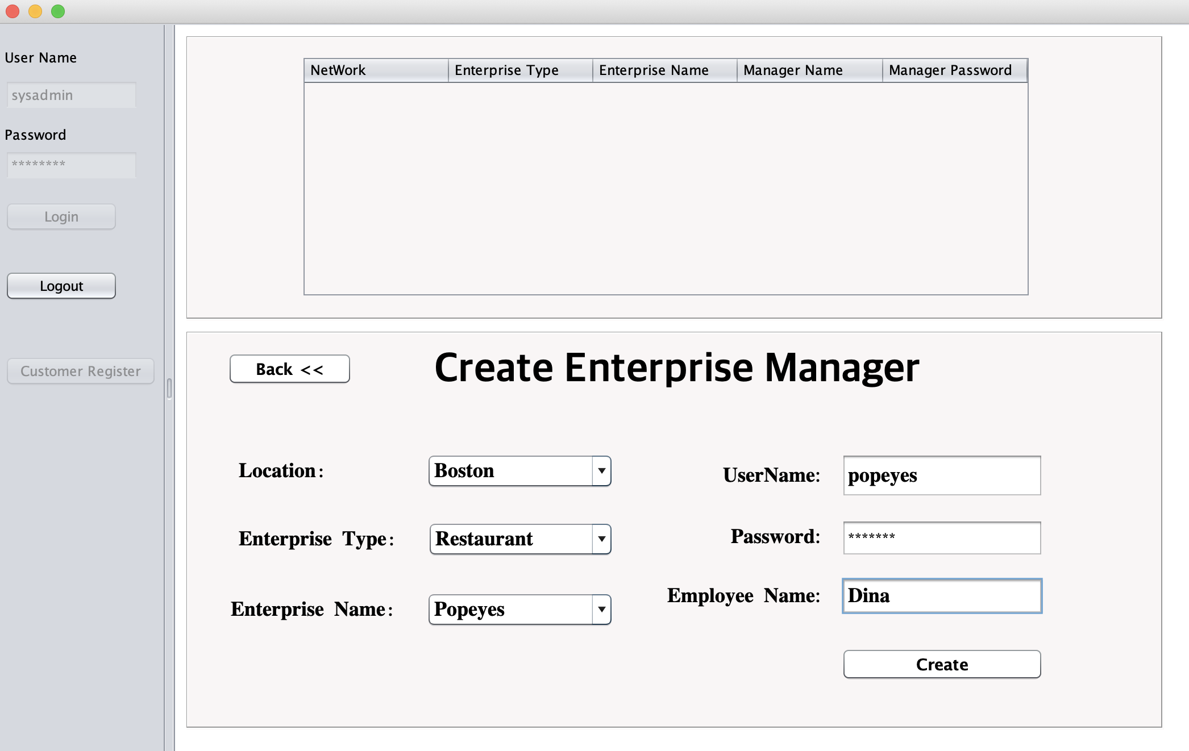

Slide 23
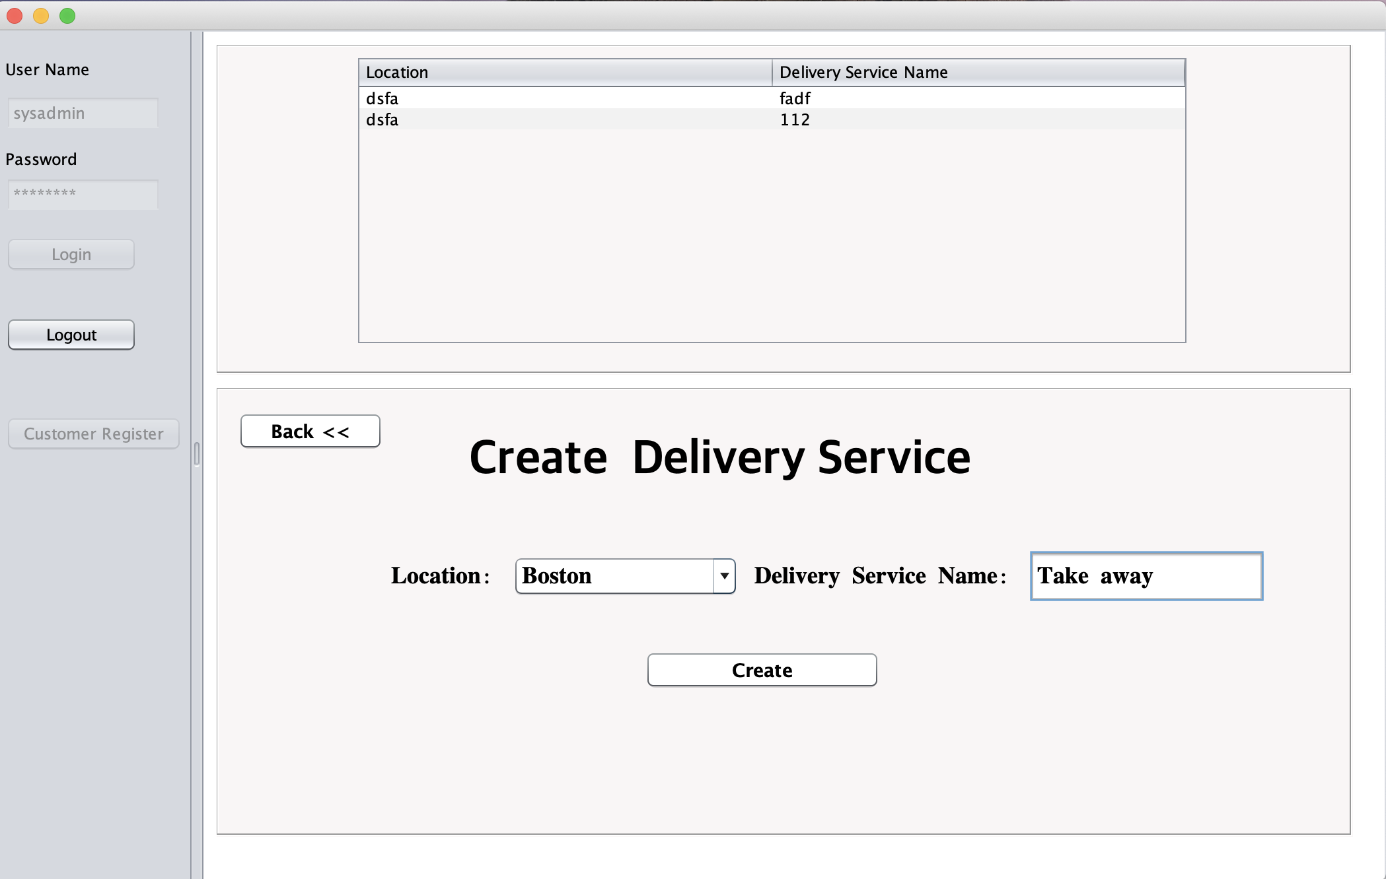

Slide 24
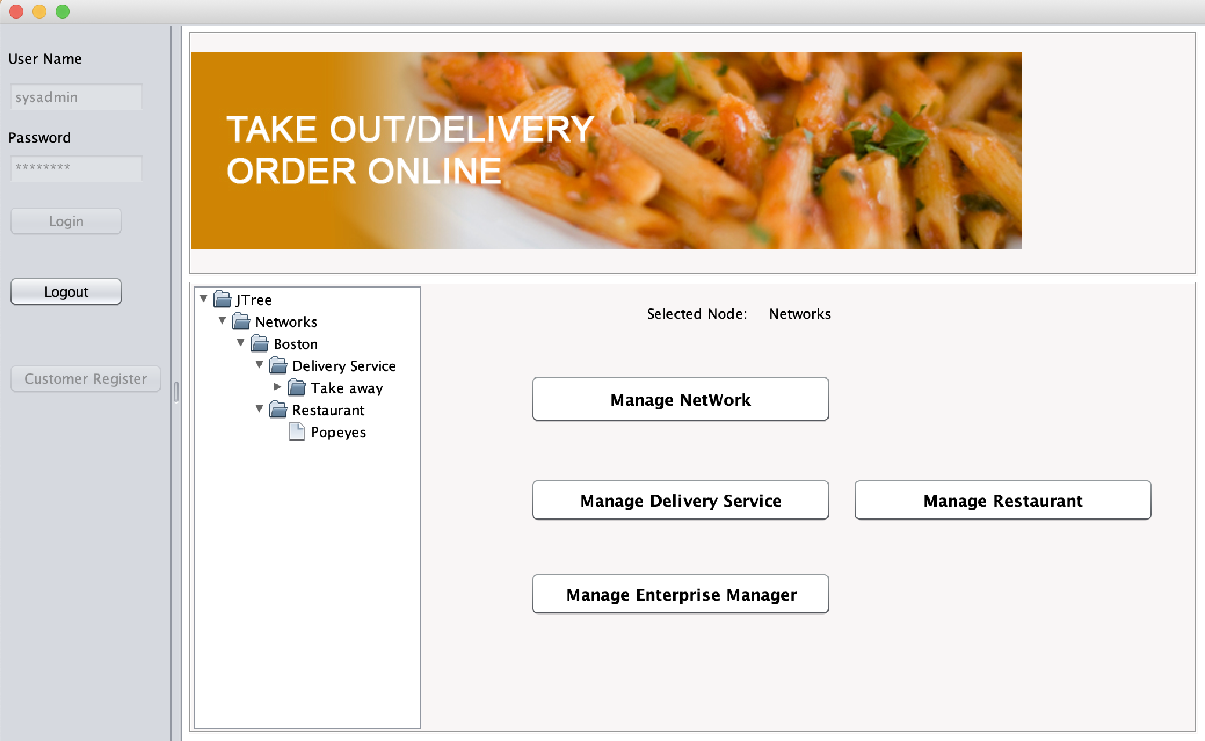

Slide 25
Restaurant Admin
Login as a restaurant manager role;
As a restaurant manager, I can create chef in the restaurant and create user account for them;
As a manager, I can create and change menu;
As a manager, I can manage order and view the evaluation;

Slide 26
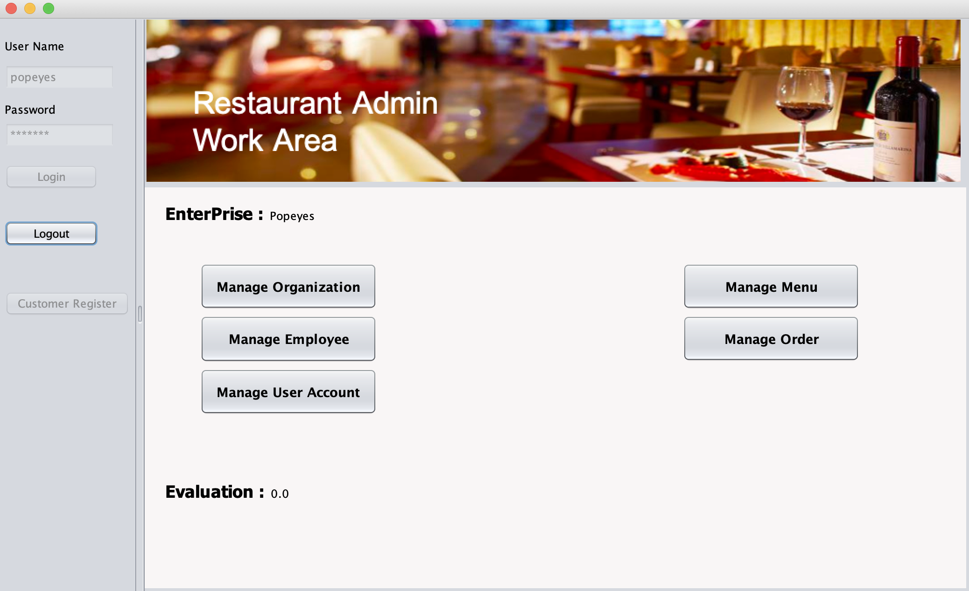

Slide 27
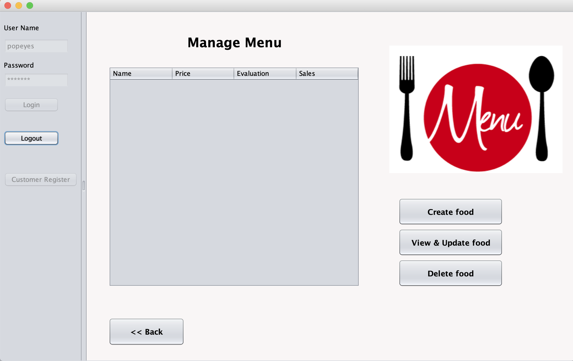

Slide 28
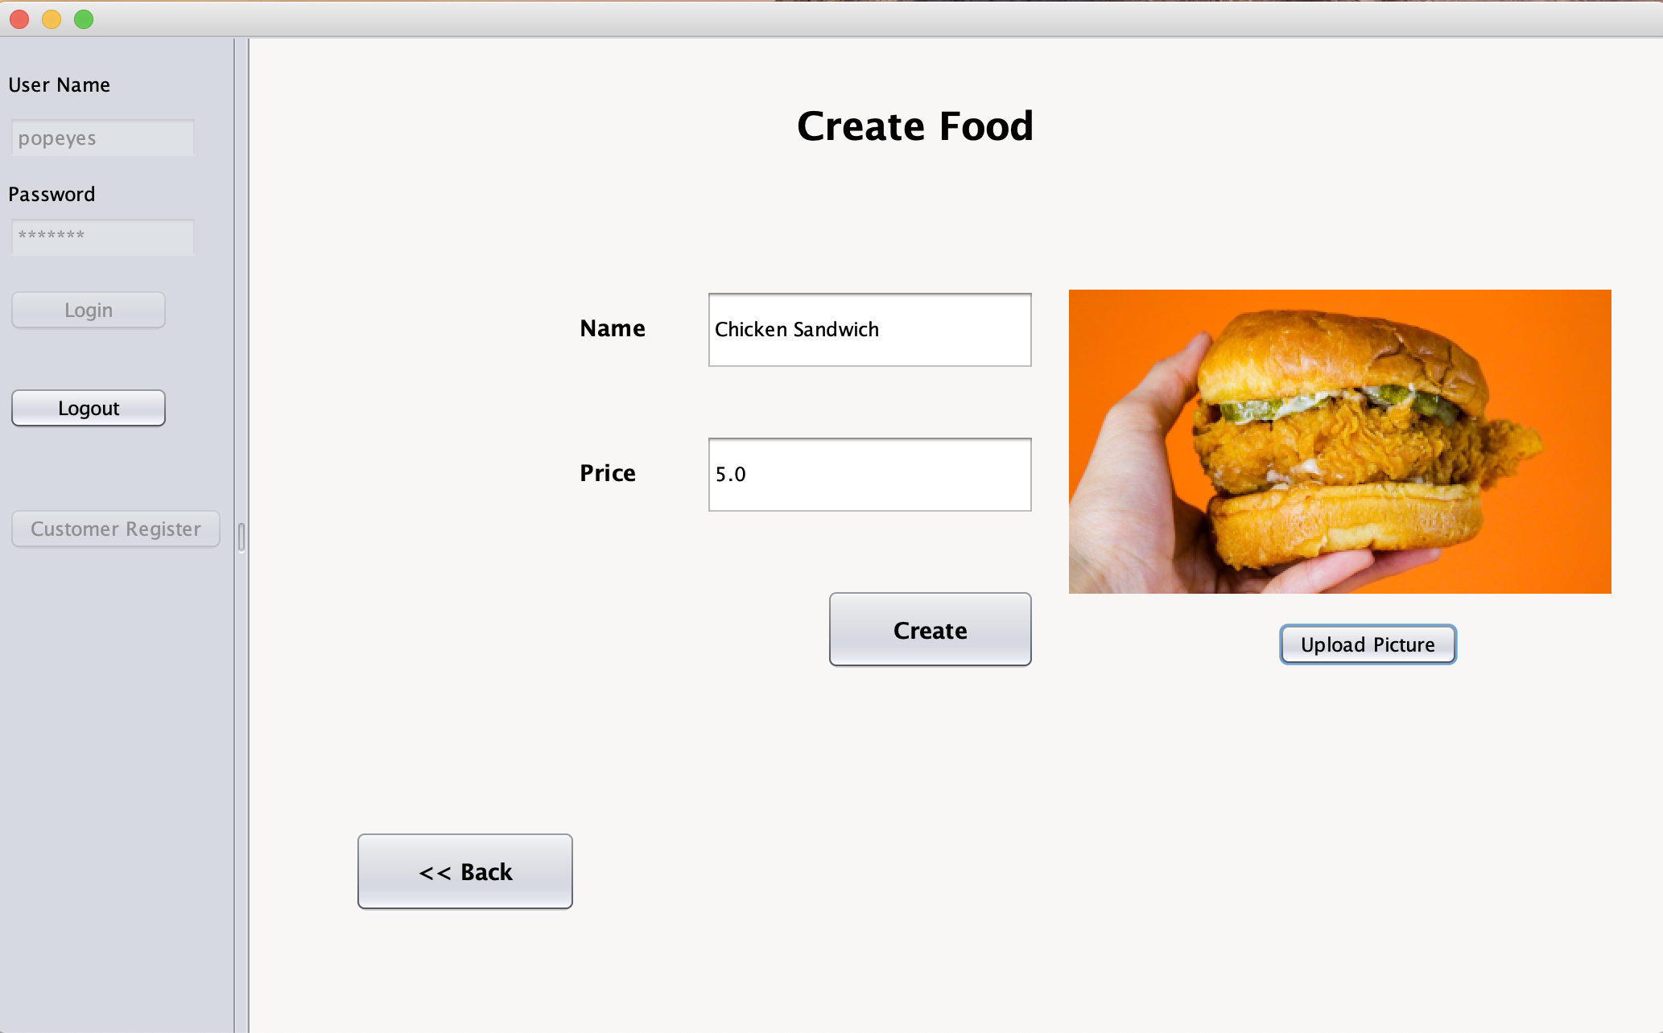

Slide 29
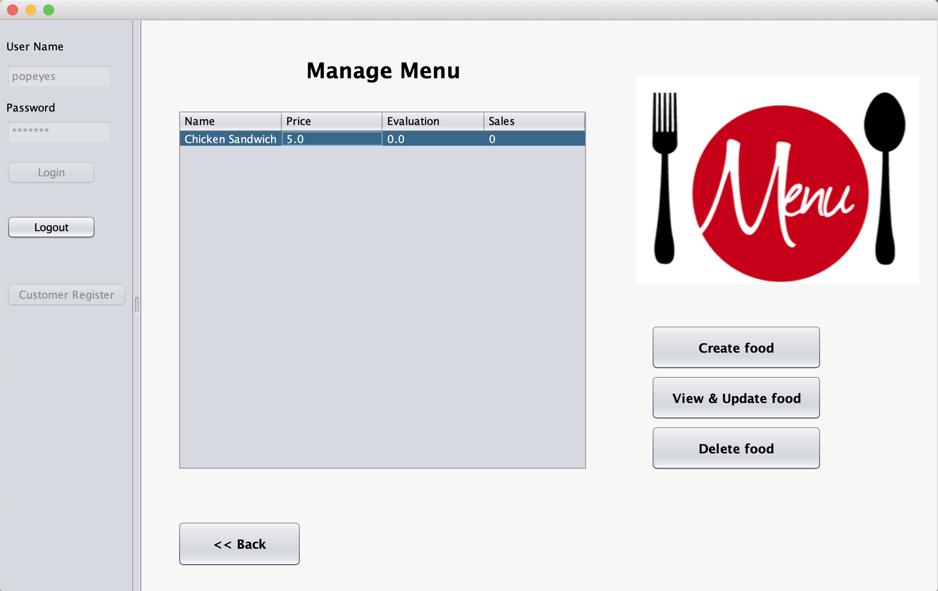

Slide 30
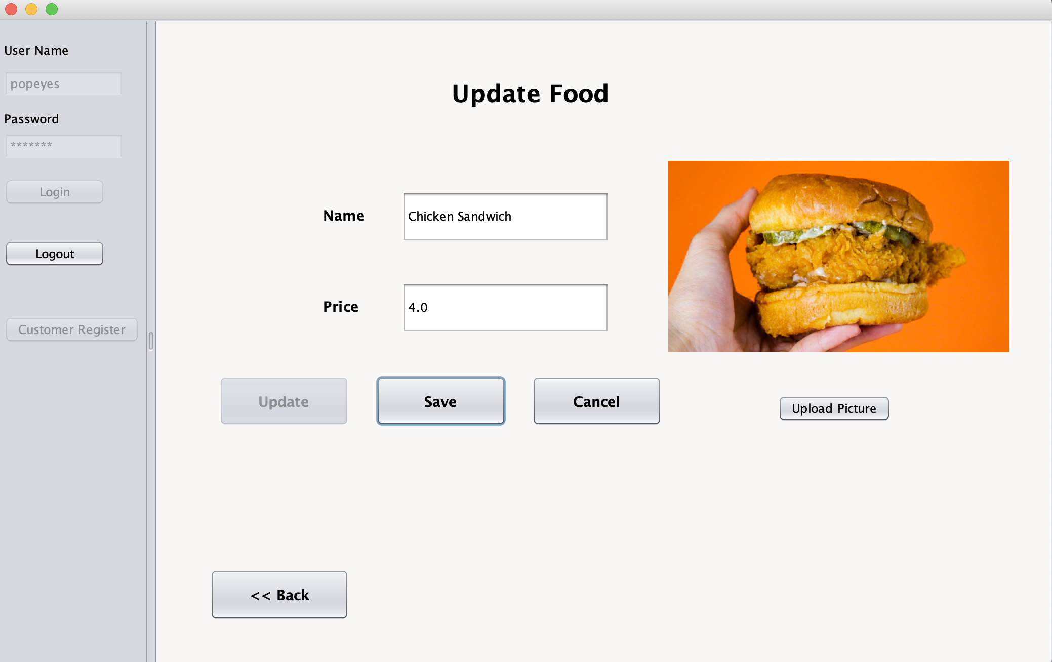

Slide 31
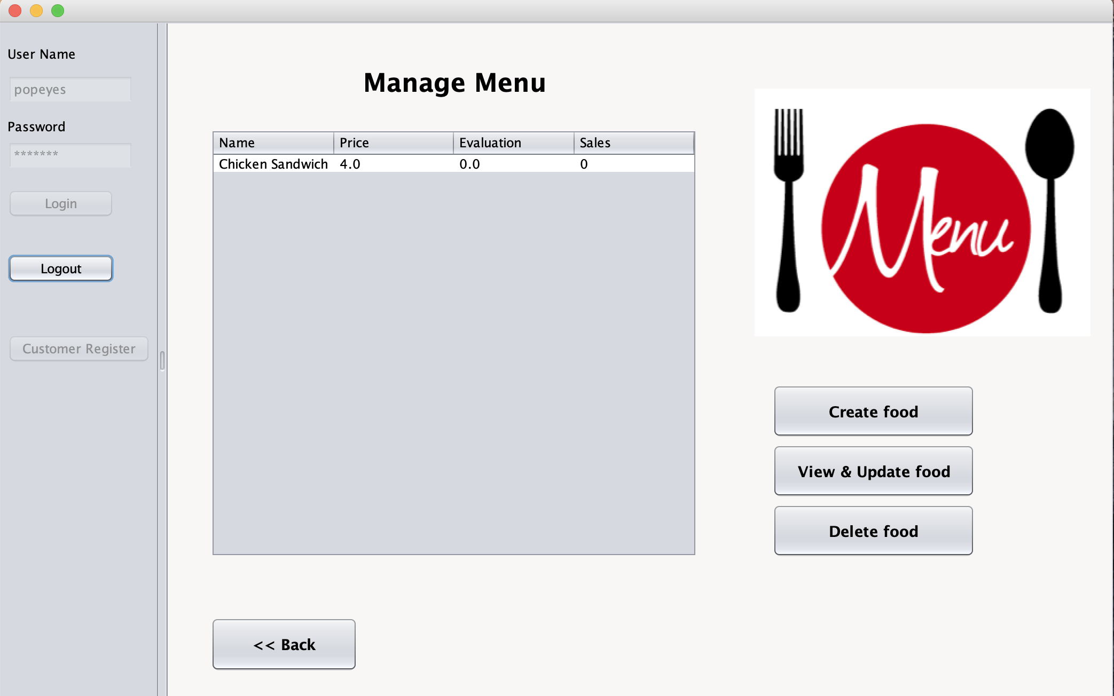

Slide 32
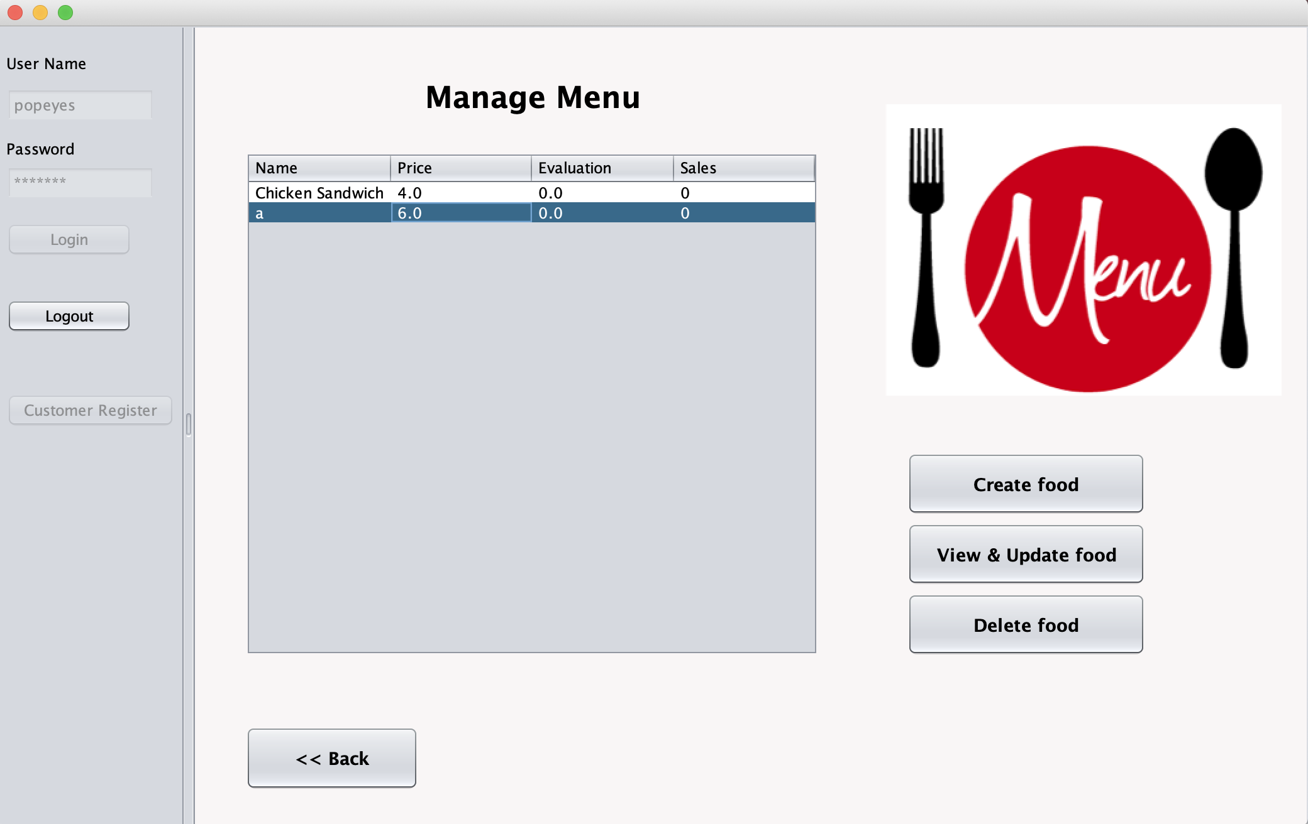

Slide 33
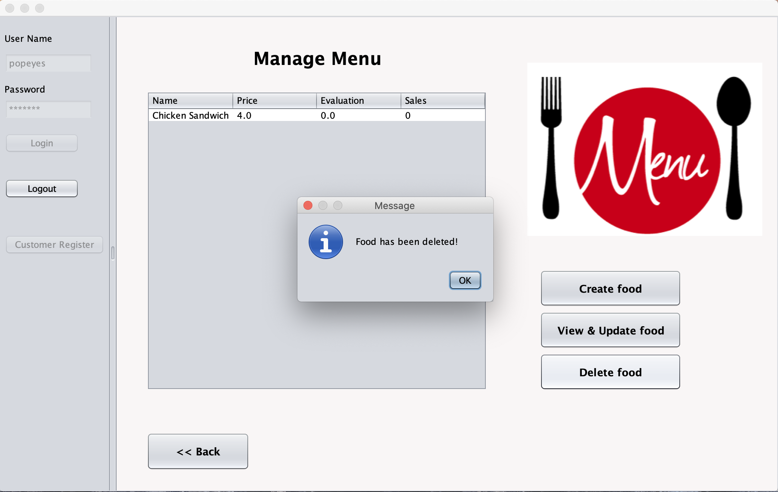

Slide 34
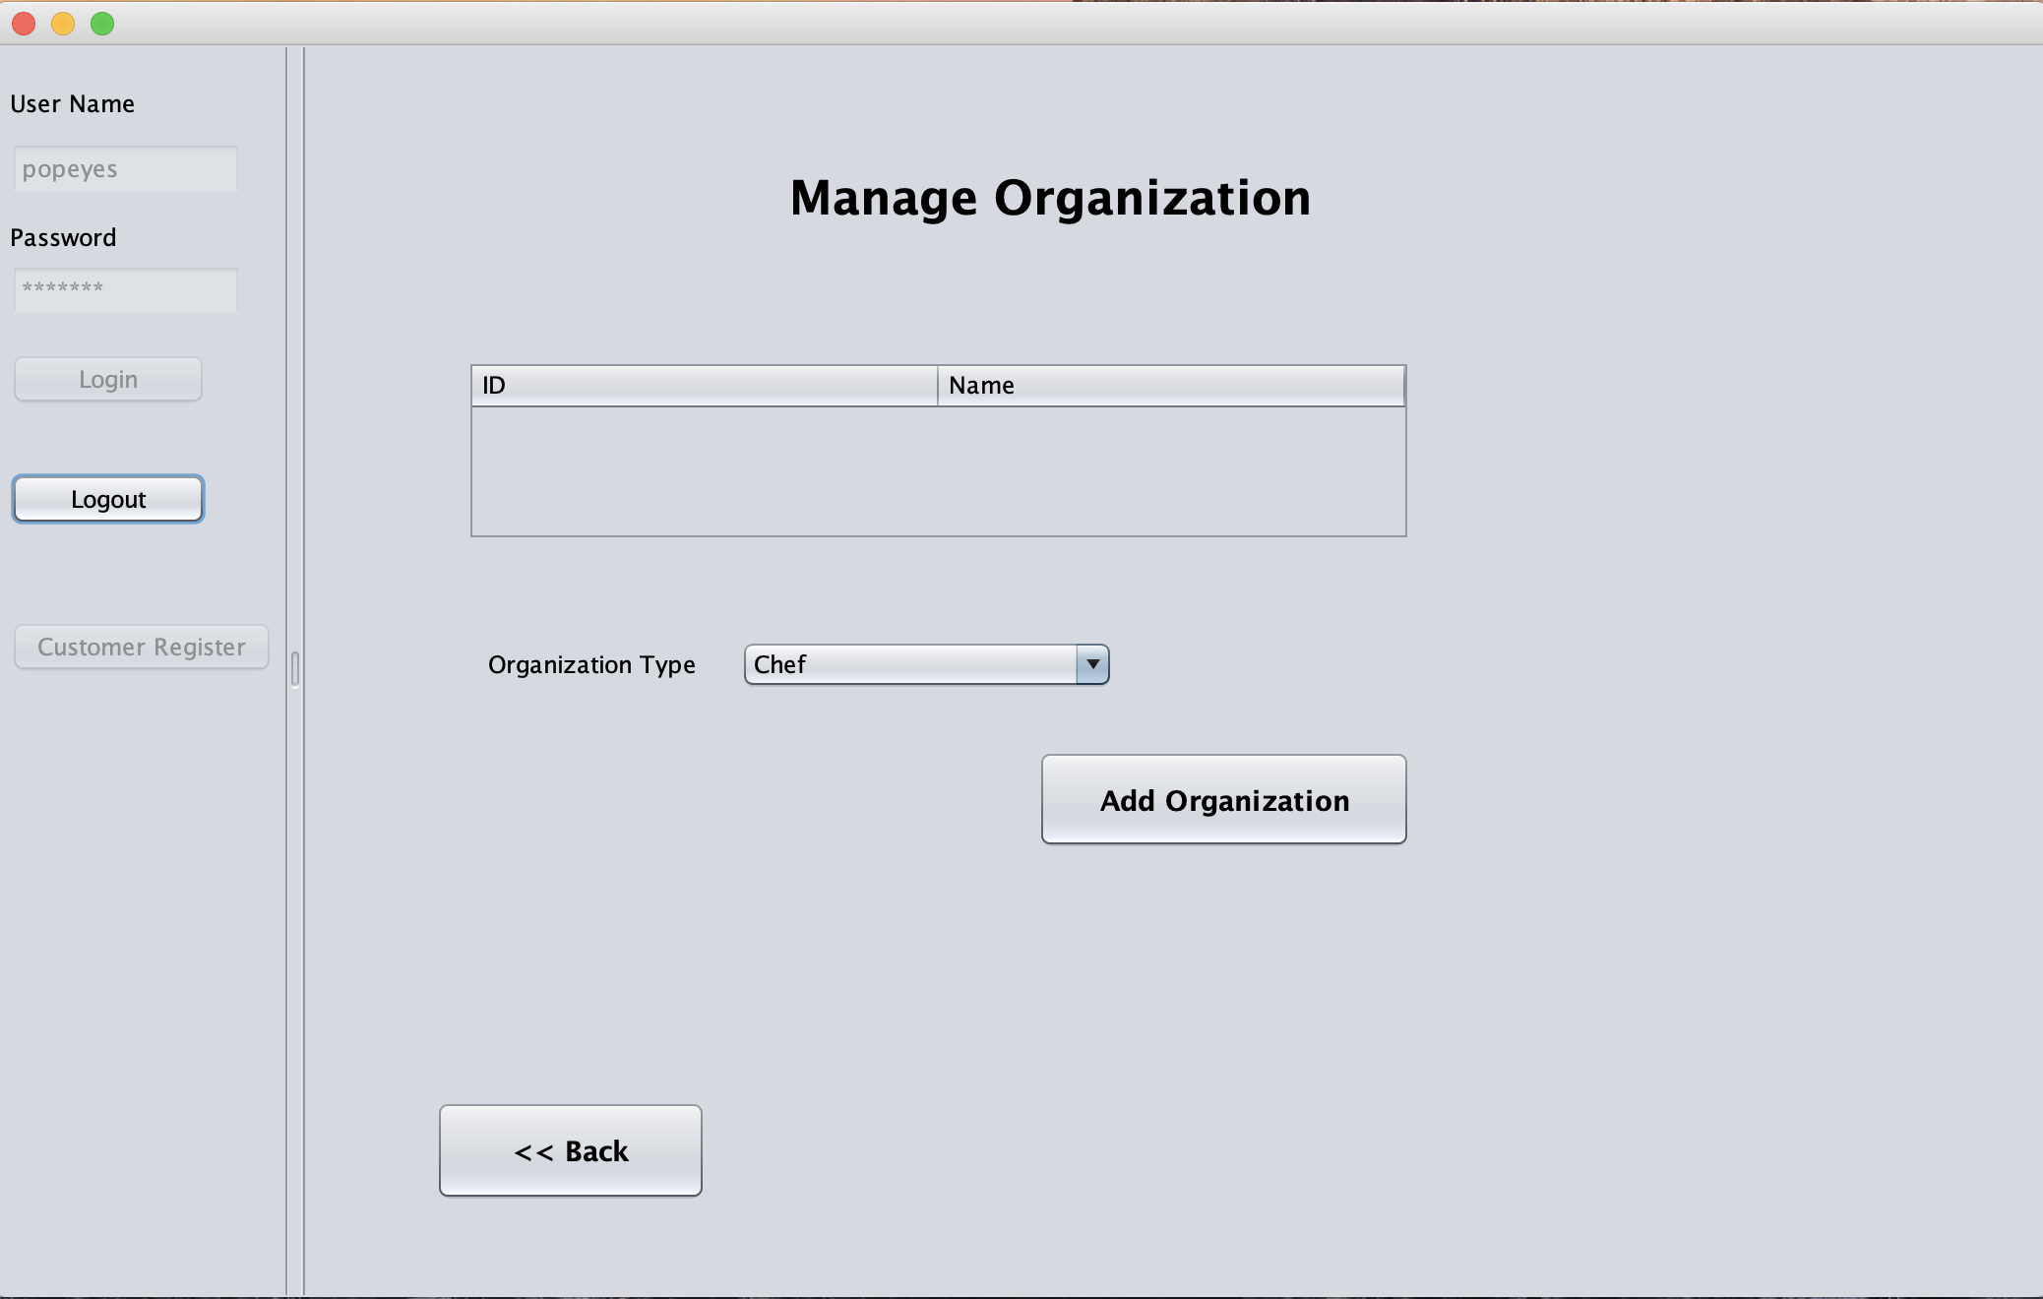

Slide 35
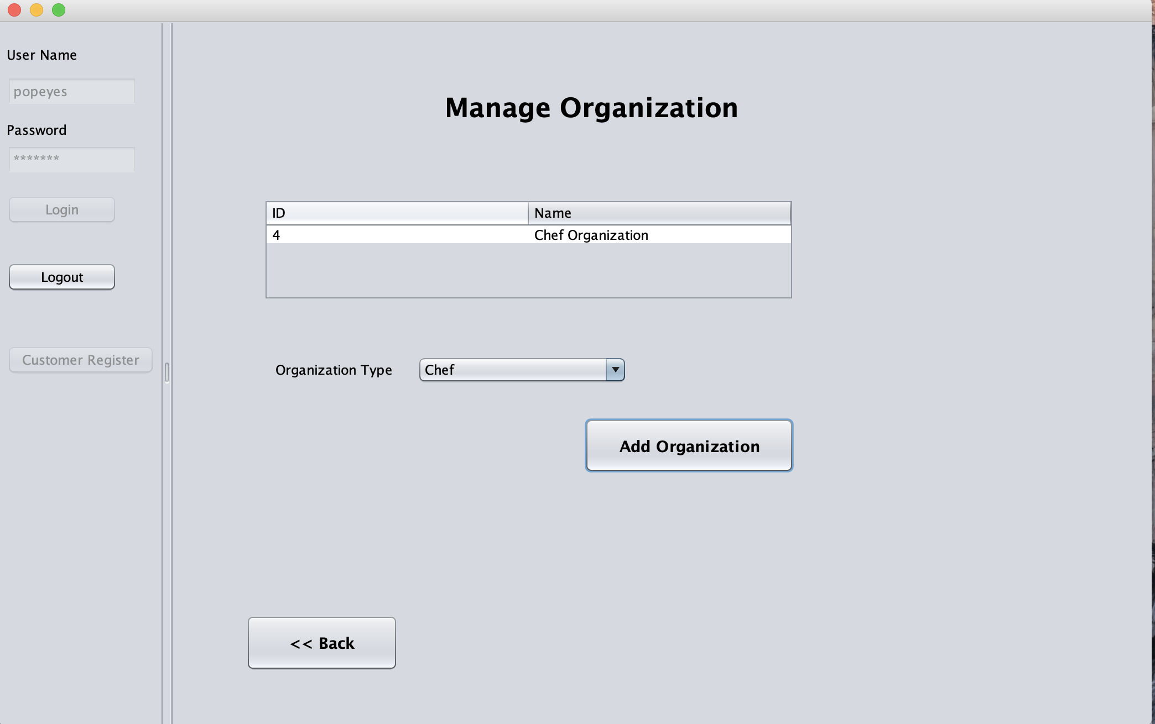

Slide 36
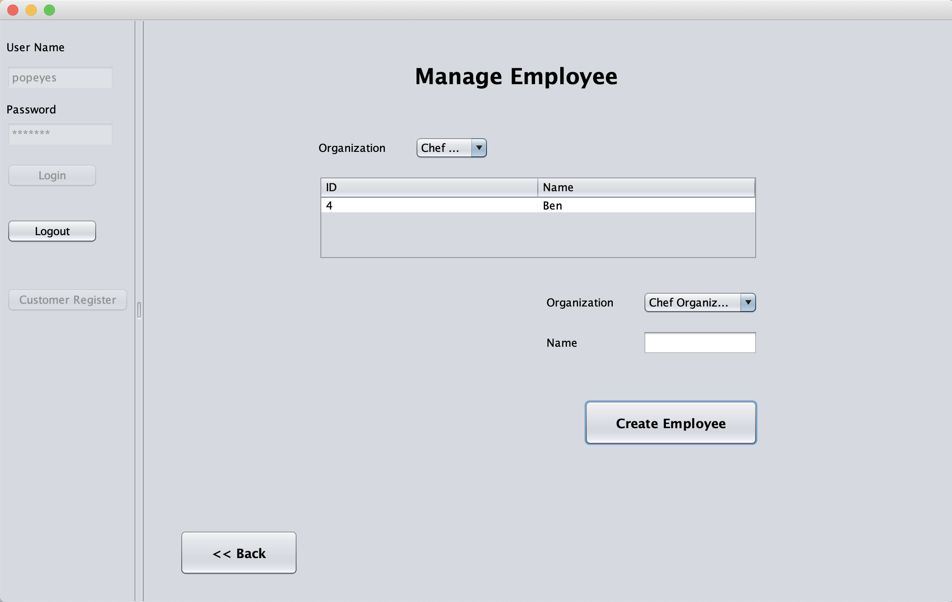

Slide 37
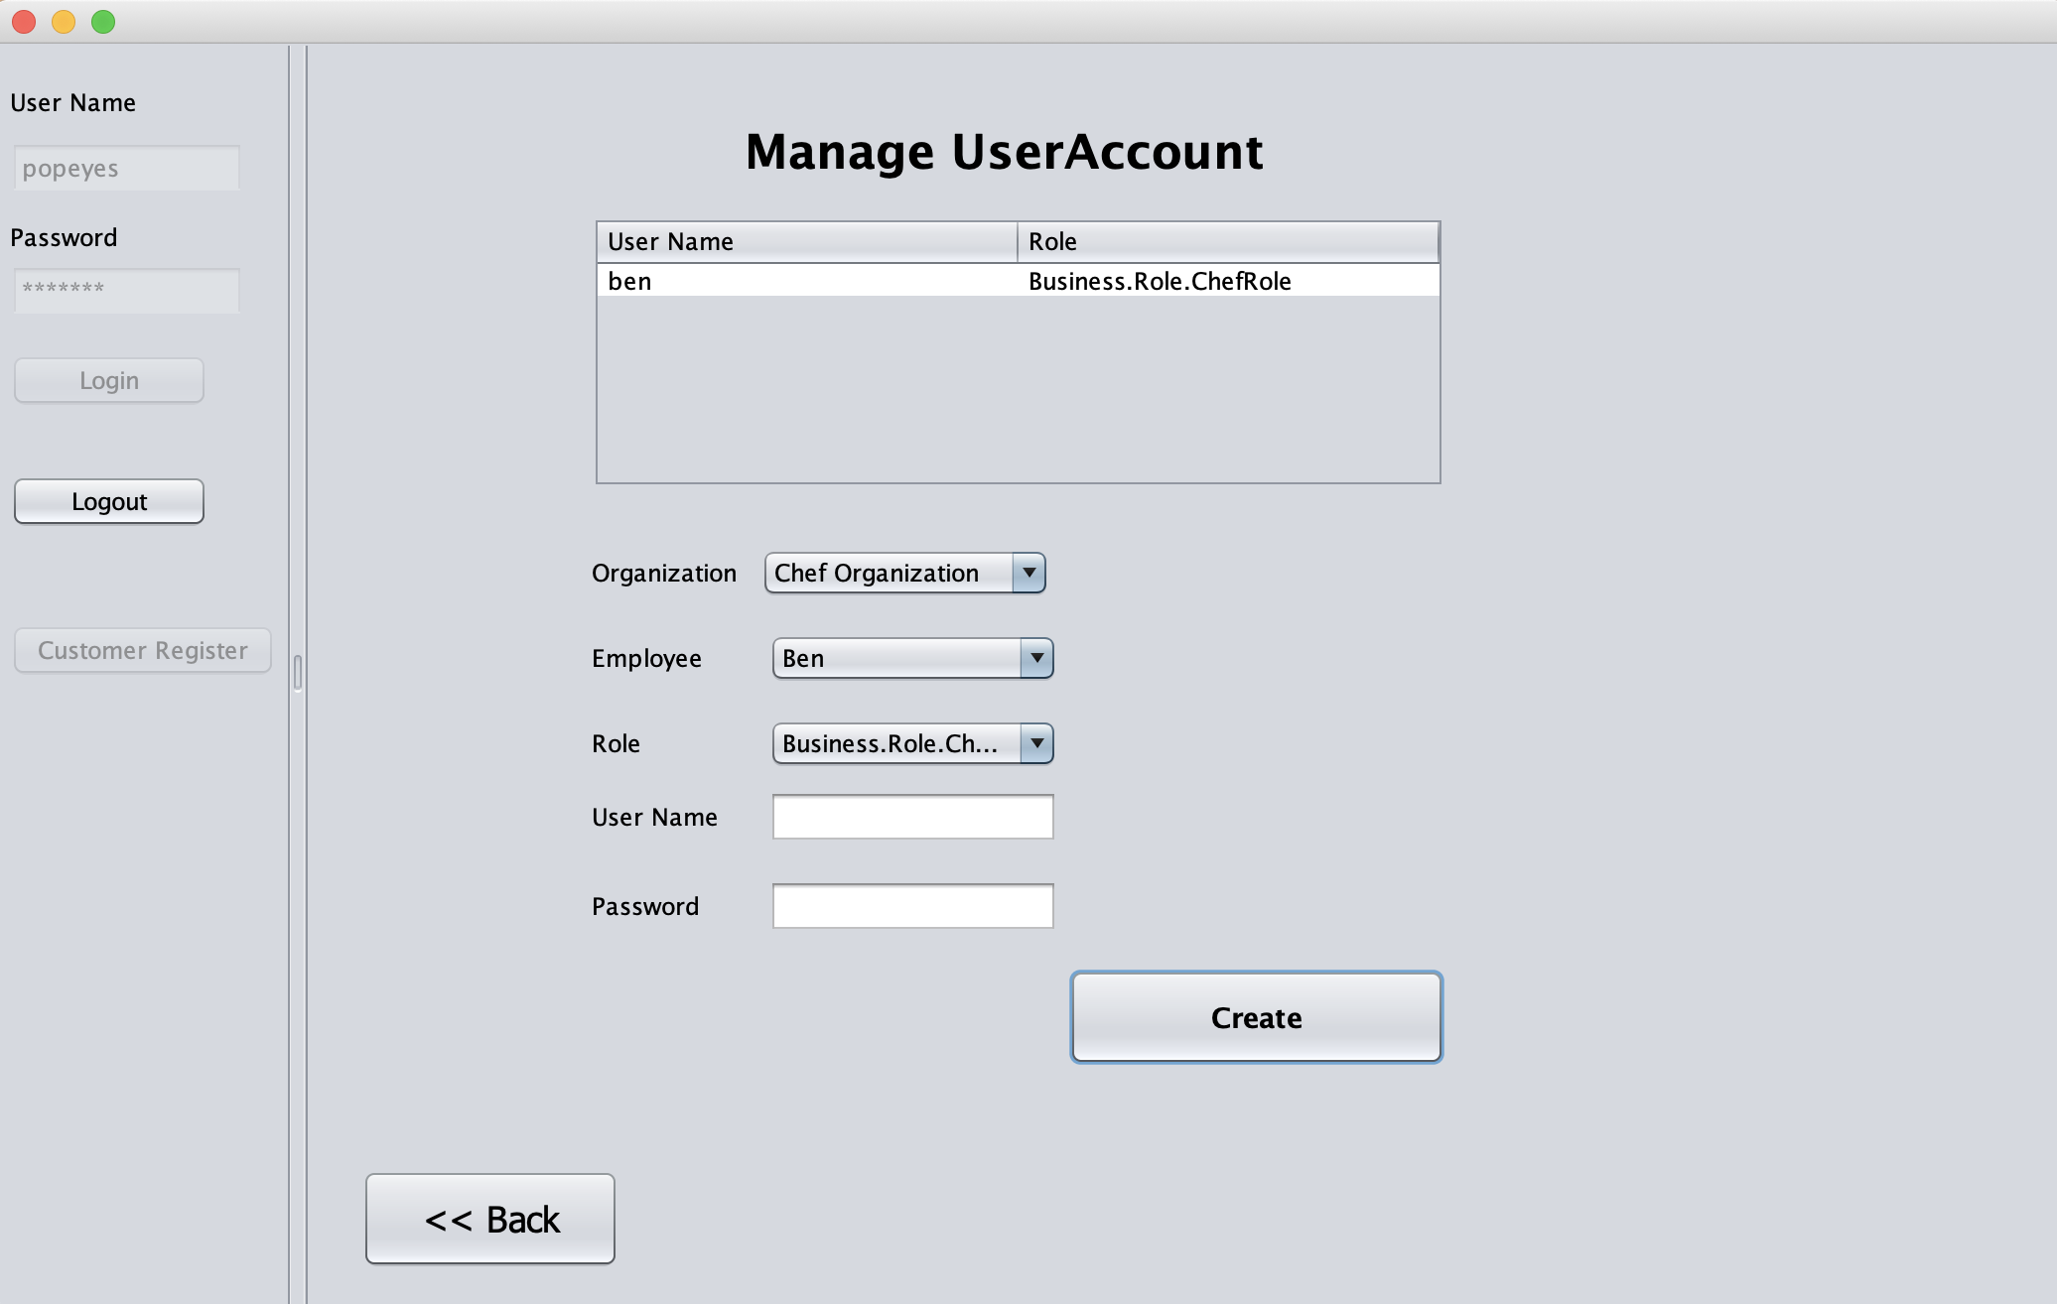

Slide 38
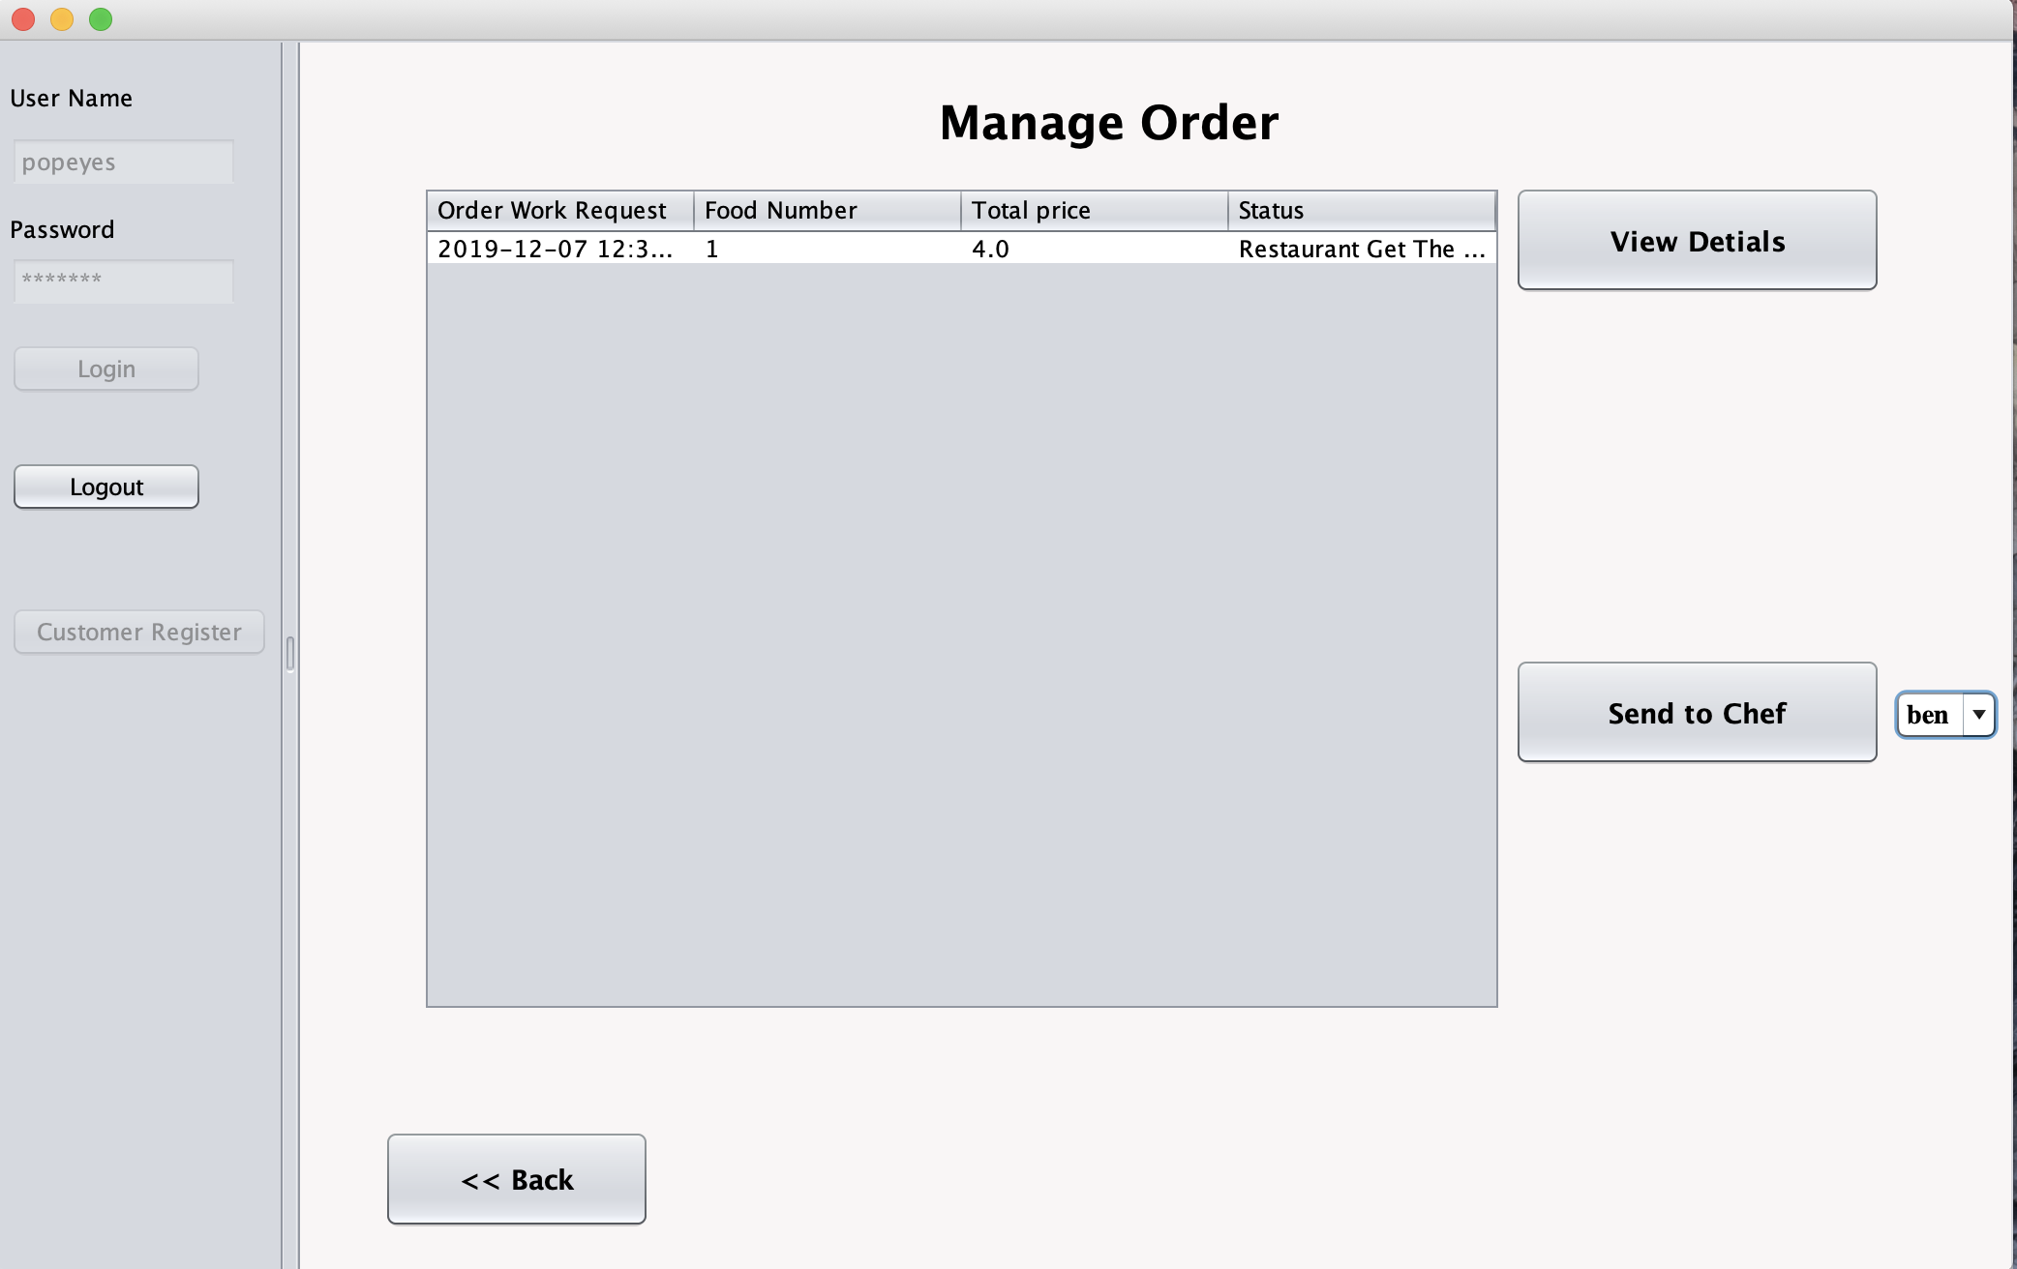

Slide 39
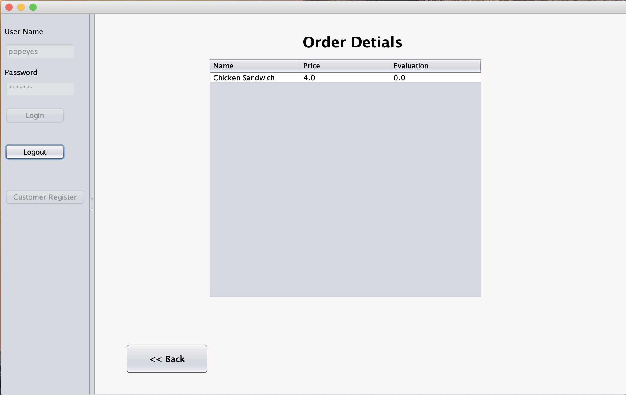

Slide 40
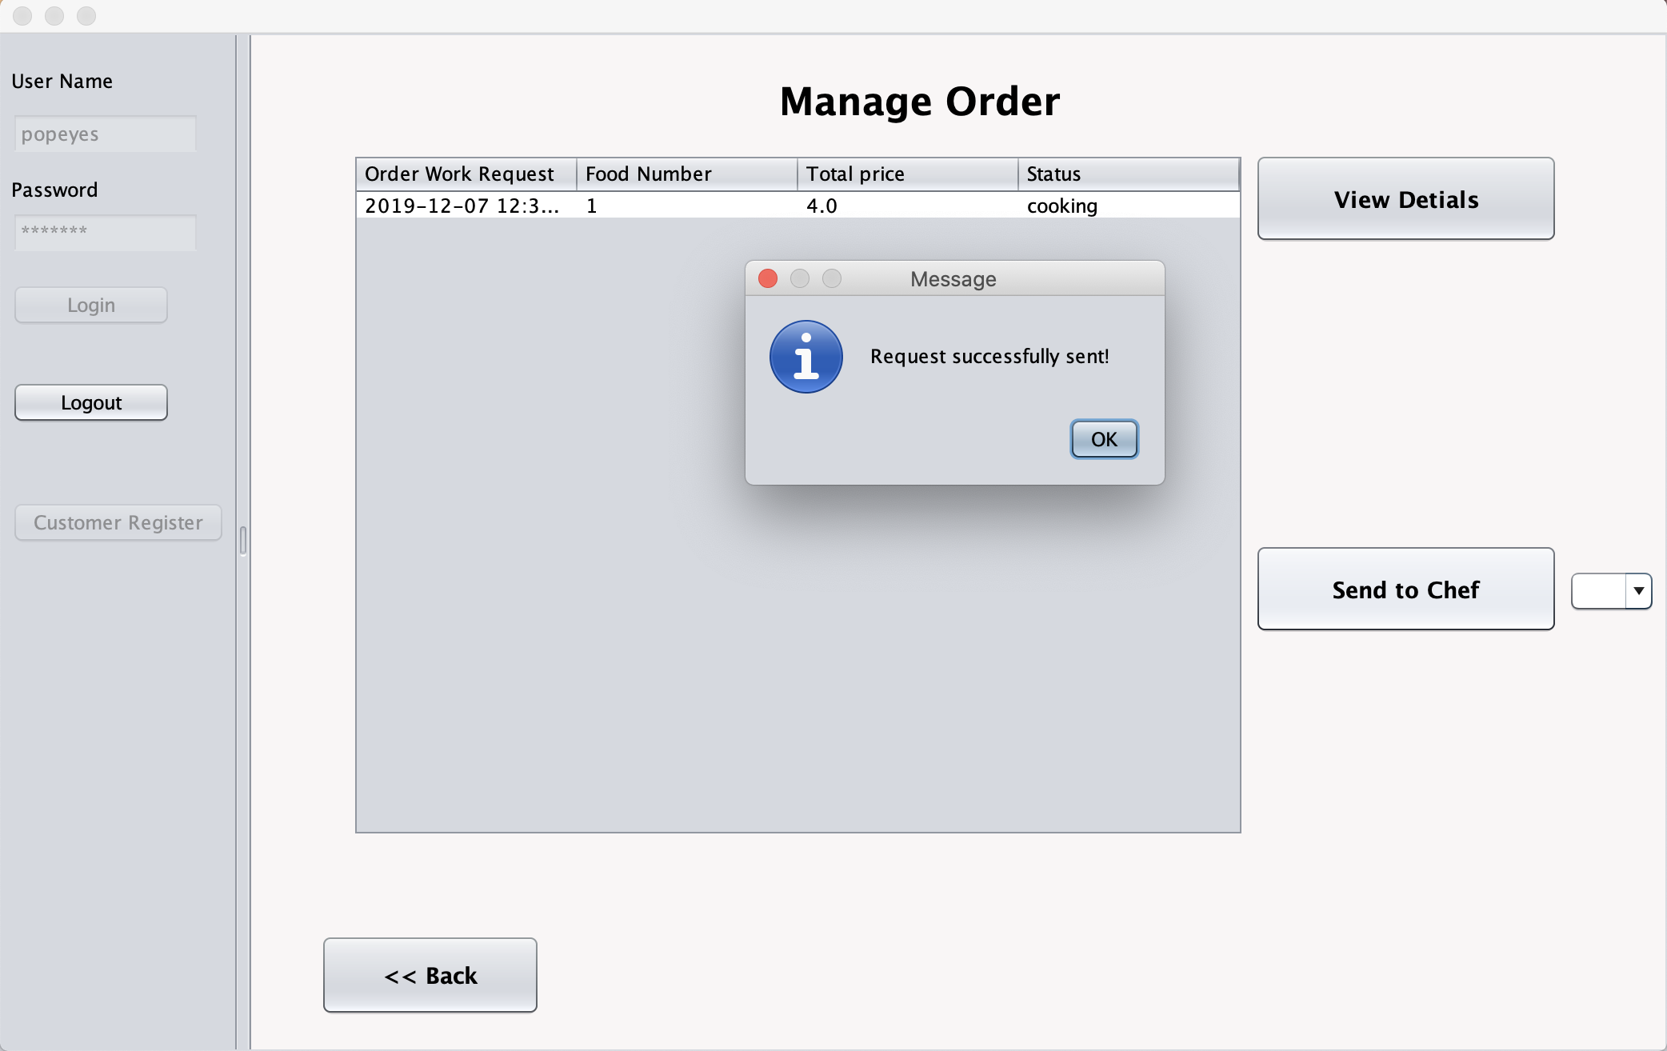

Slide 41
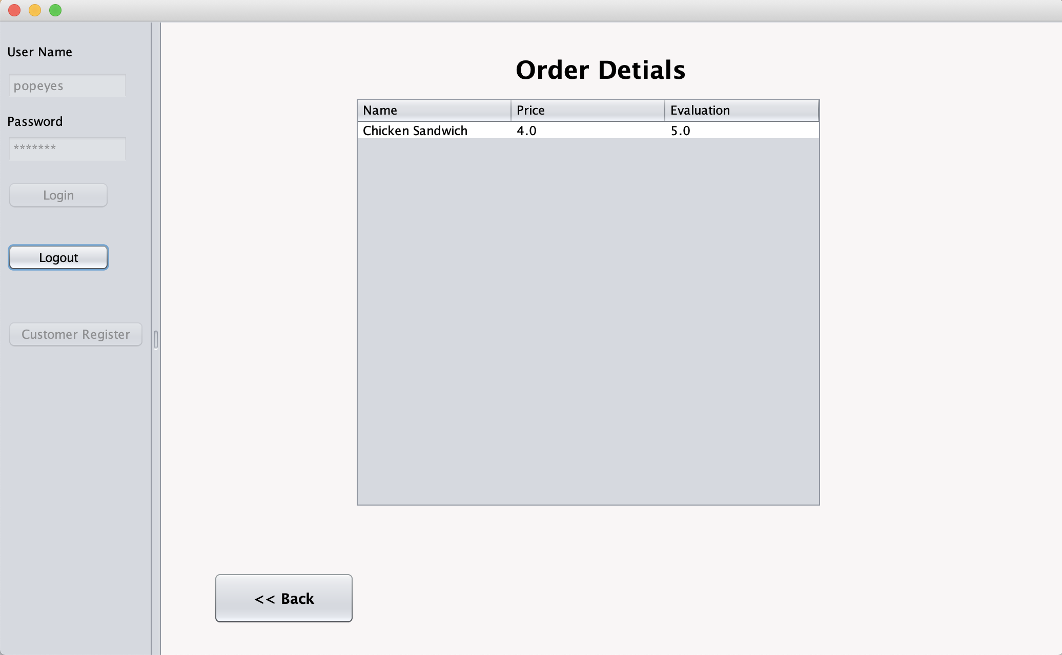

Slide 42
Chef
Login as an employee role;
As an employee, I can view the request sent from the restaurant;
After cooking food of the order, click the finish button to Change the status;

Slide 43
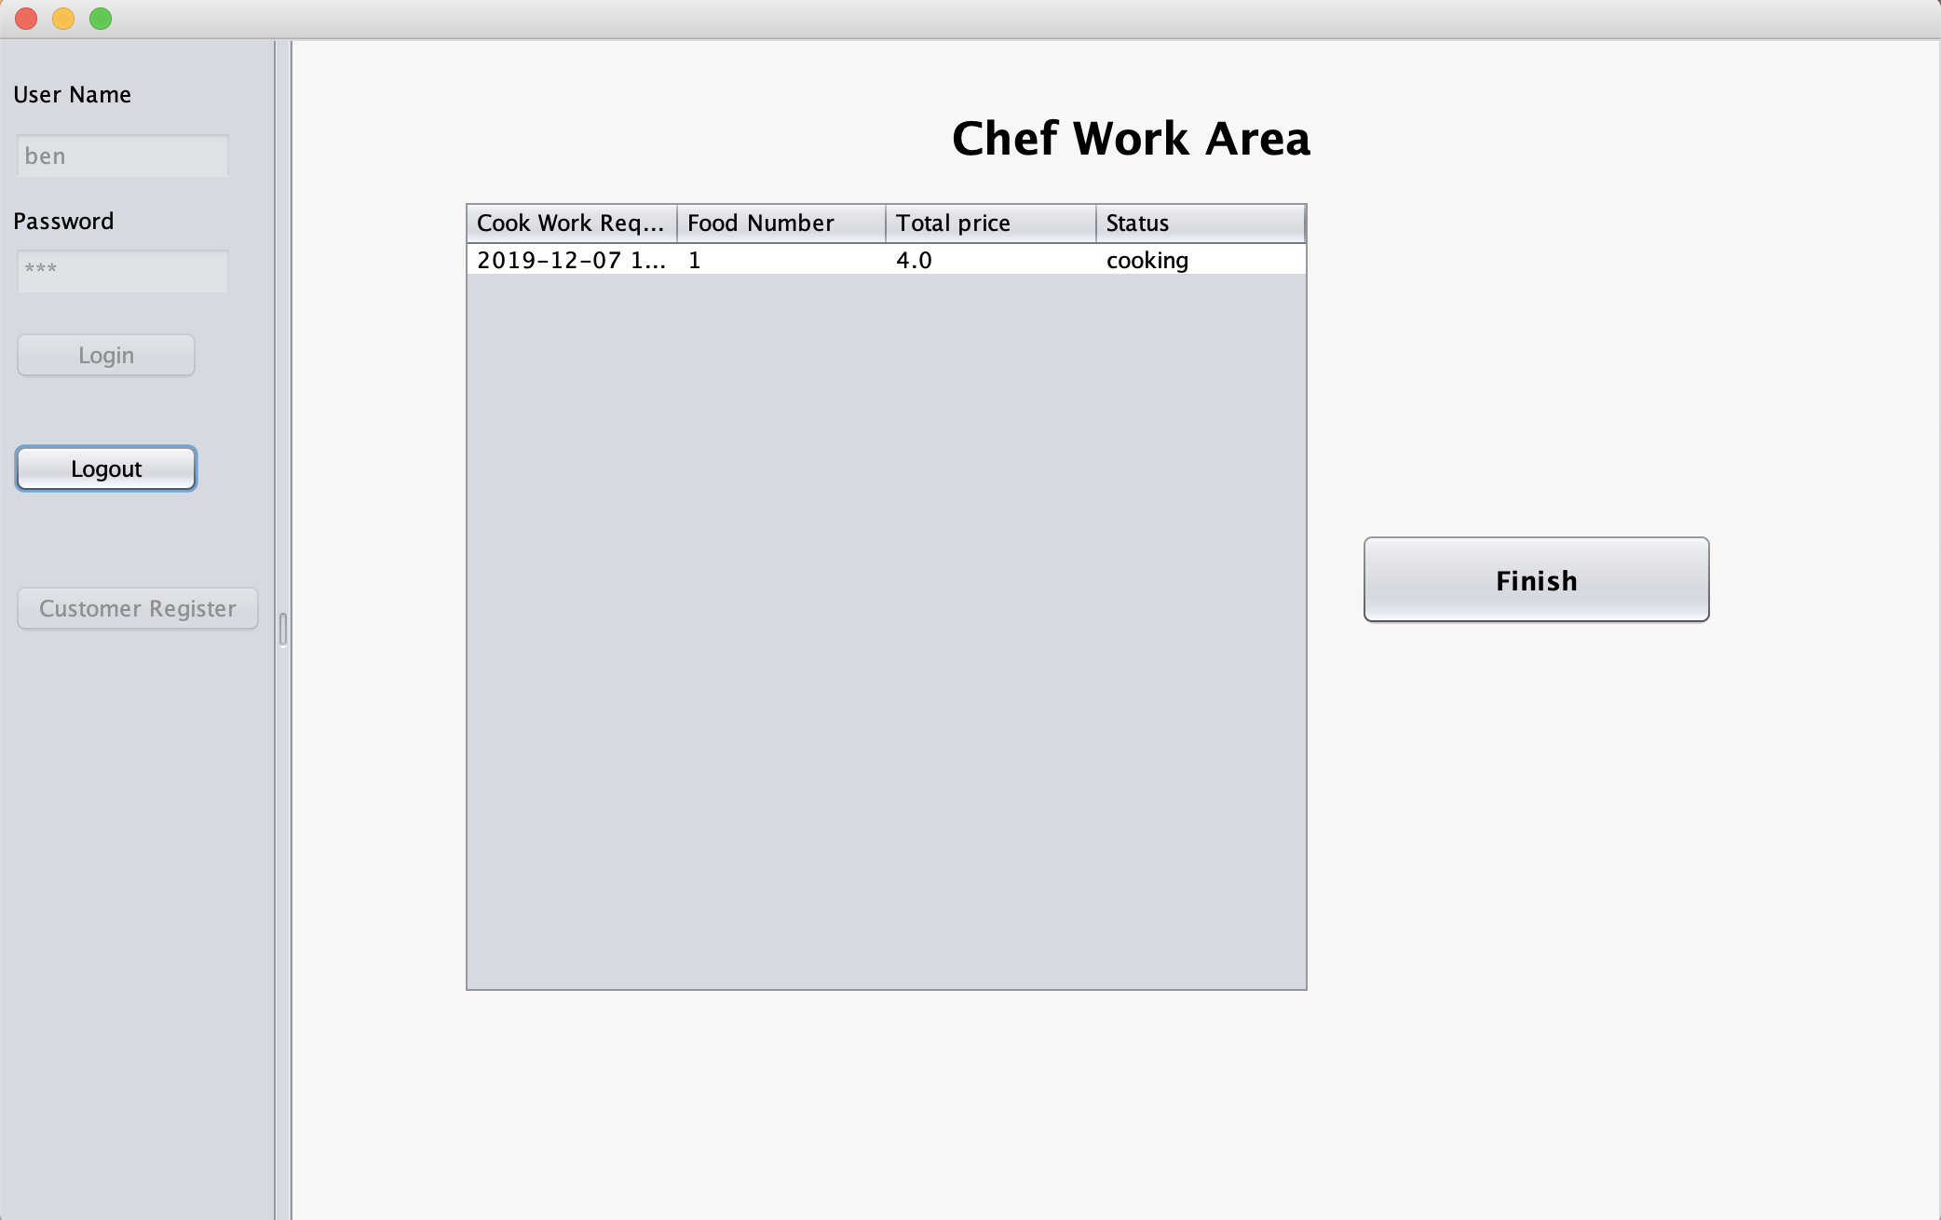

Slide 44
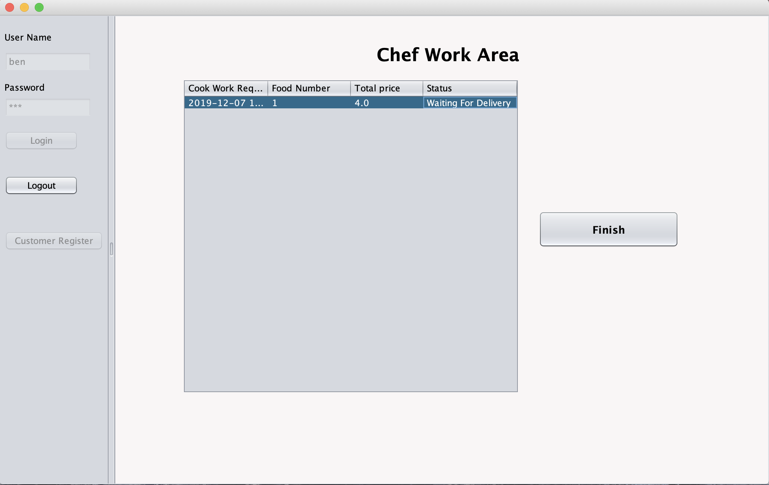

Slide 45
Delivery Service Admin
Login as a delivery manager role;
Manage delivery guy organization;
As a delivery manager, I can create an employee in the company and manage their account;
As a delivery manager, I can manage order, and send new delivery request to organization.

Slide 46
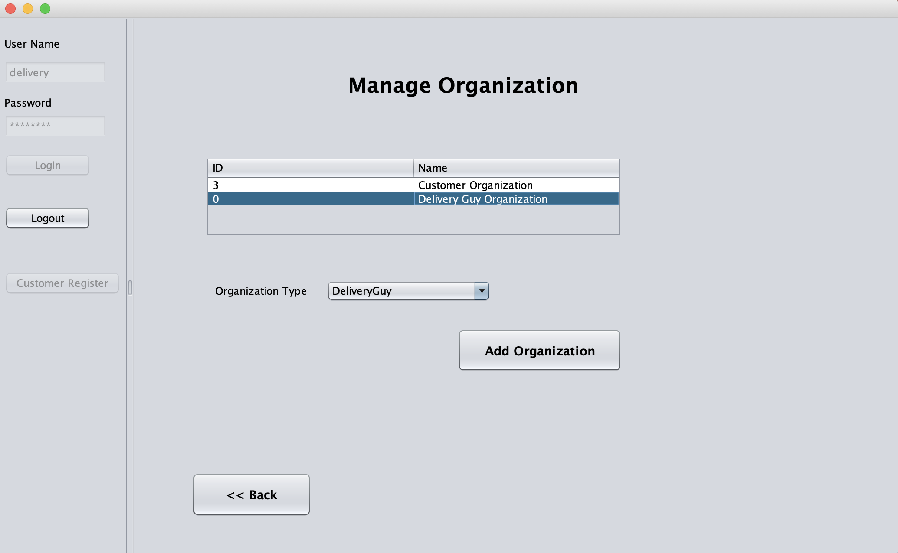

Slide 47
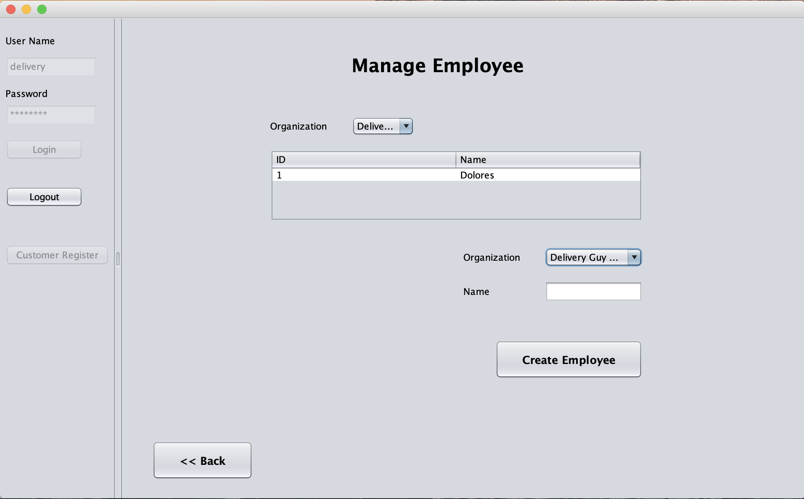

Slide 48
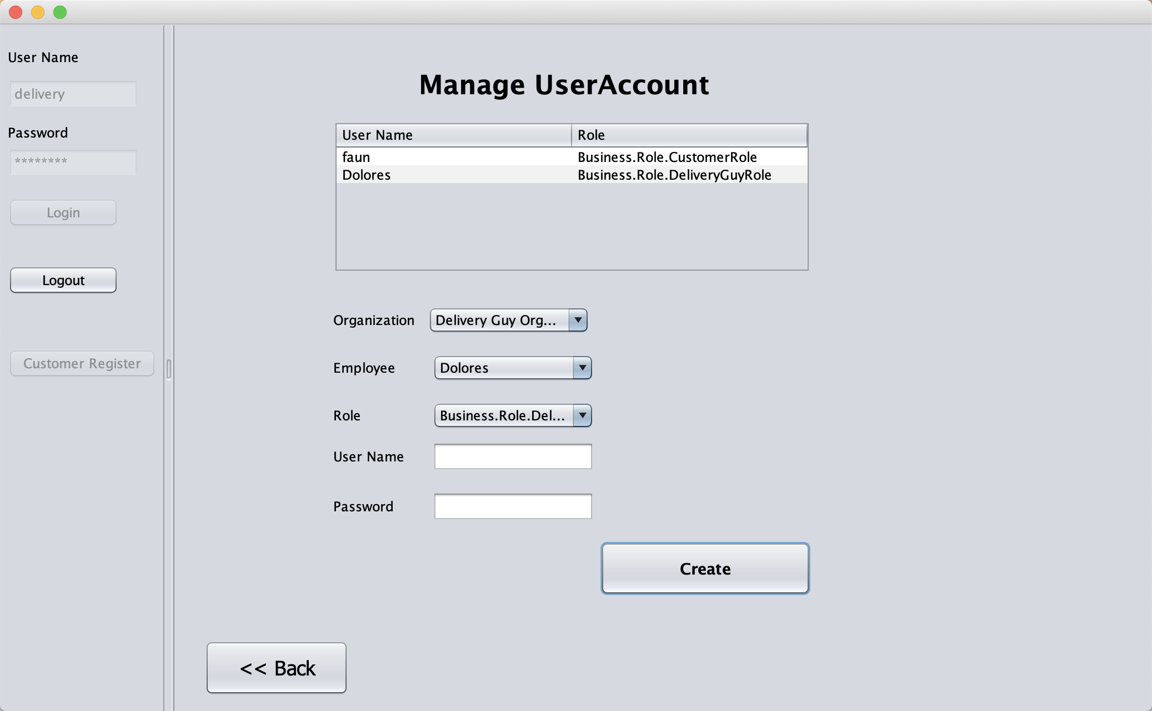

Slide 49
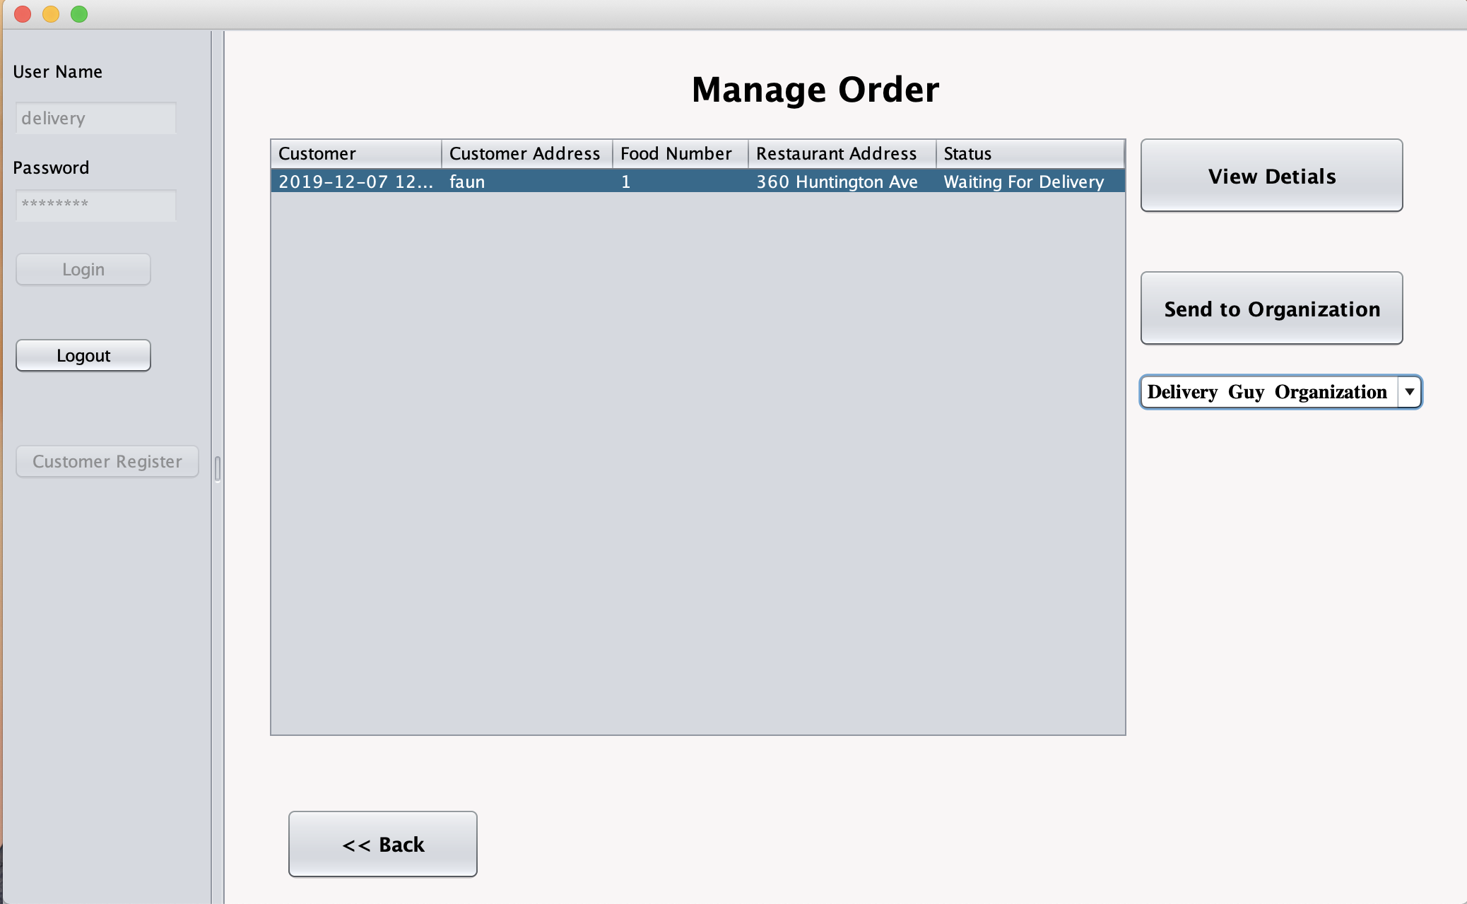

Slide 50
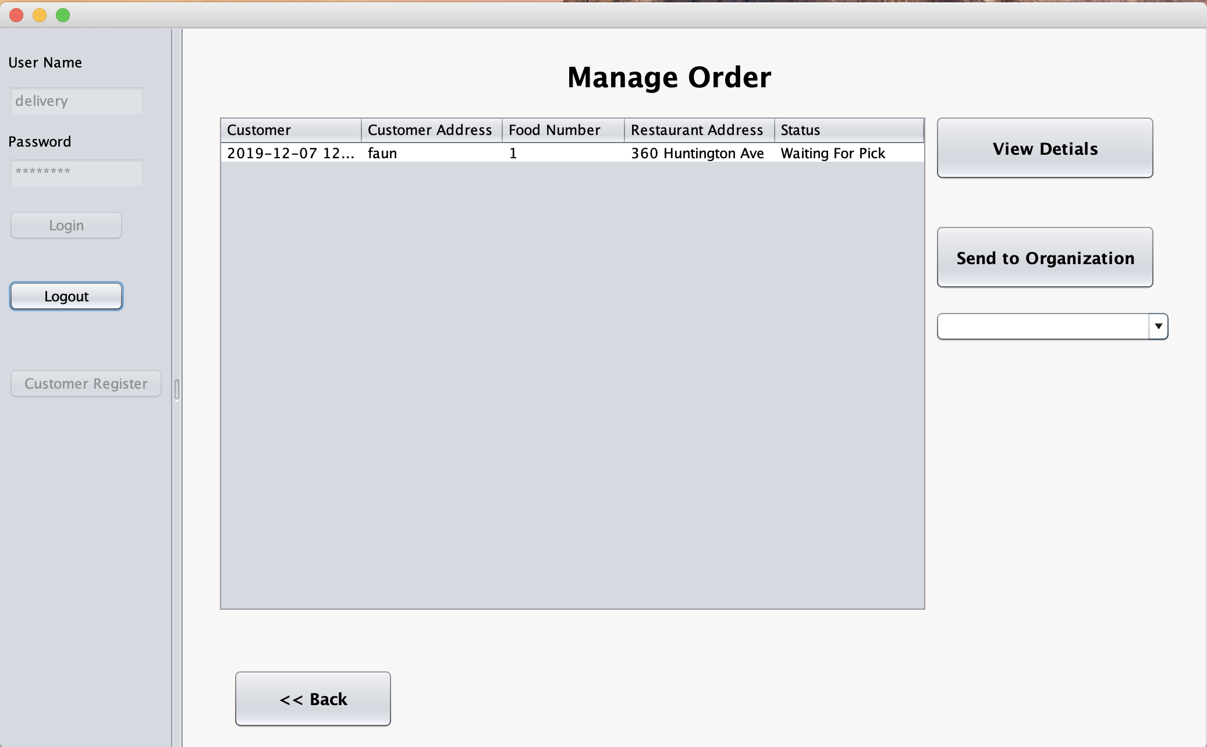

Slide 51
Delivery Guy
Login as an Delivery Guy role;
As an Delivery Guy, I can view the request sent from the Delivery Service;
I can accept delivery request, and cannot accept another delivery request until finished the first delivery request;

Slide 52
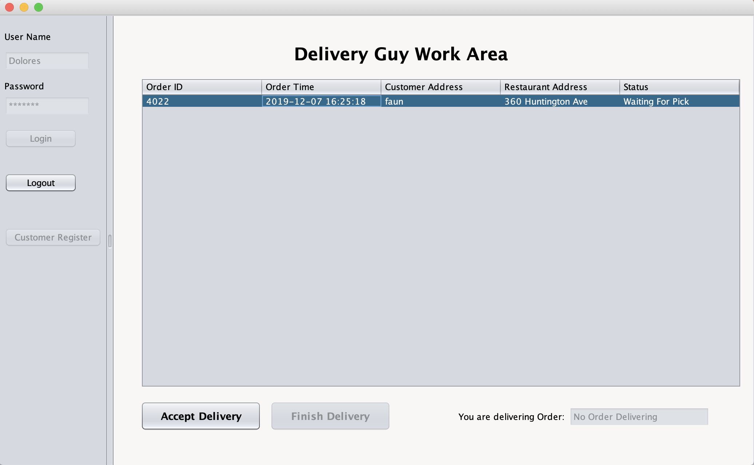

Slide 53
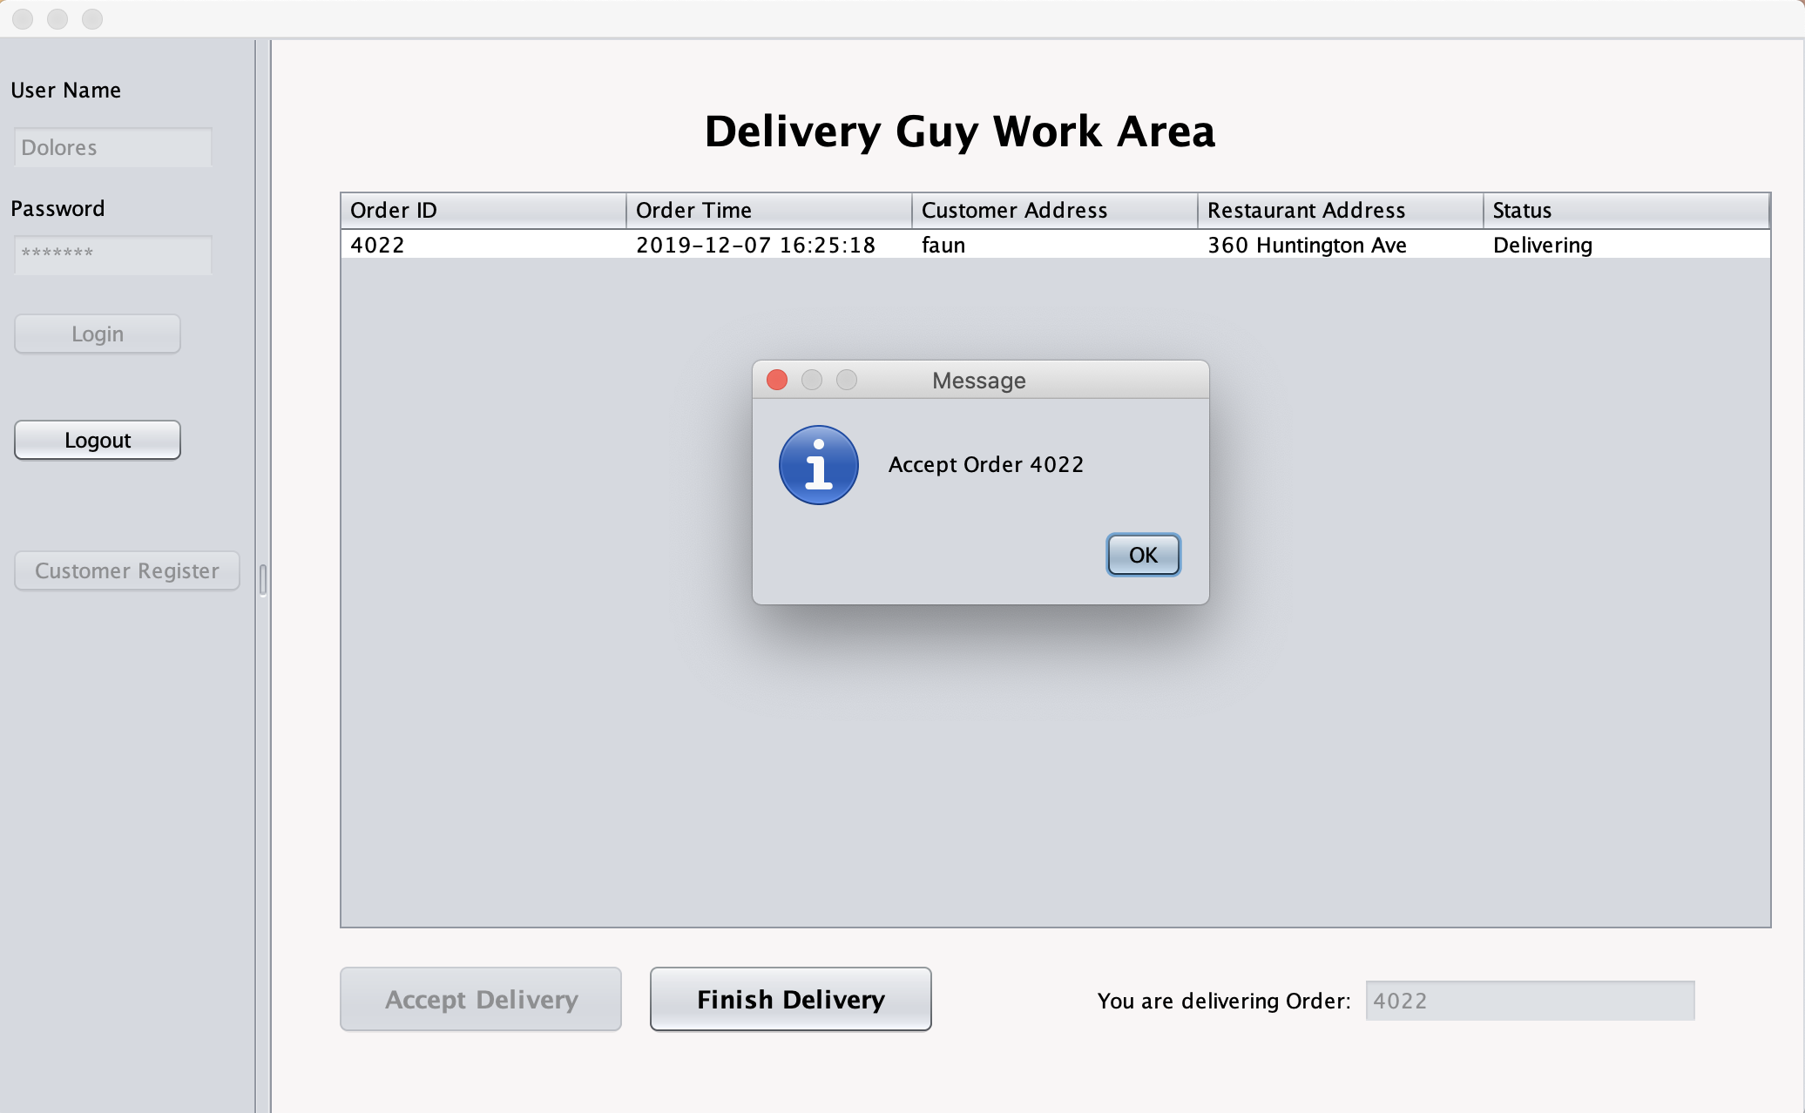

Slide 54
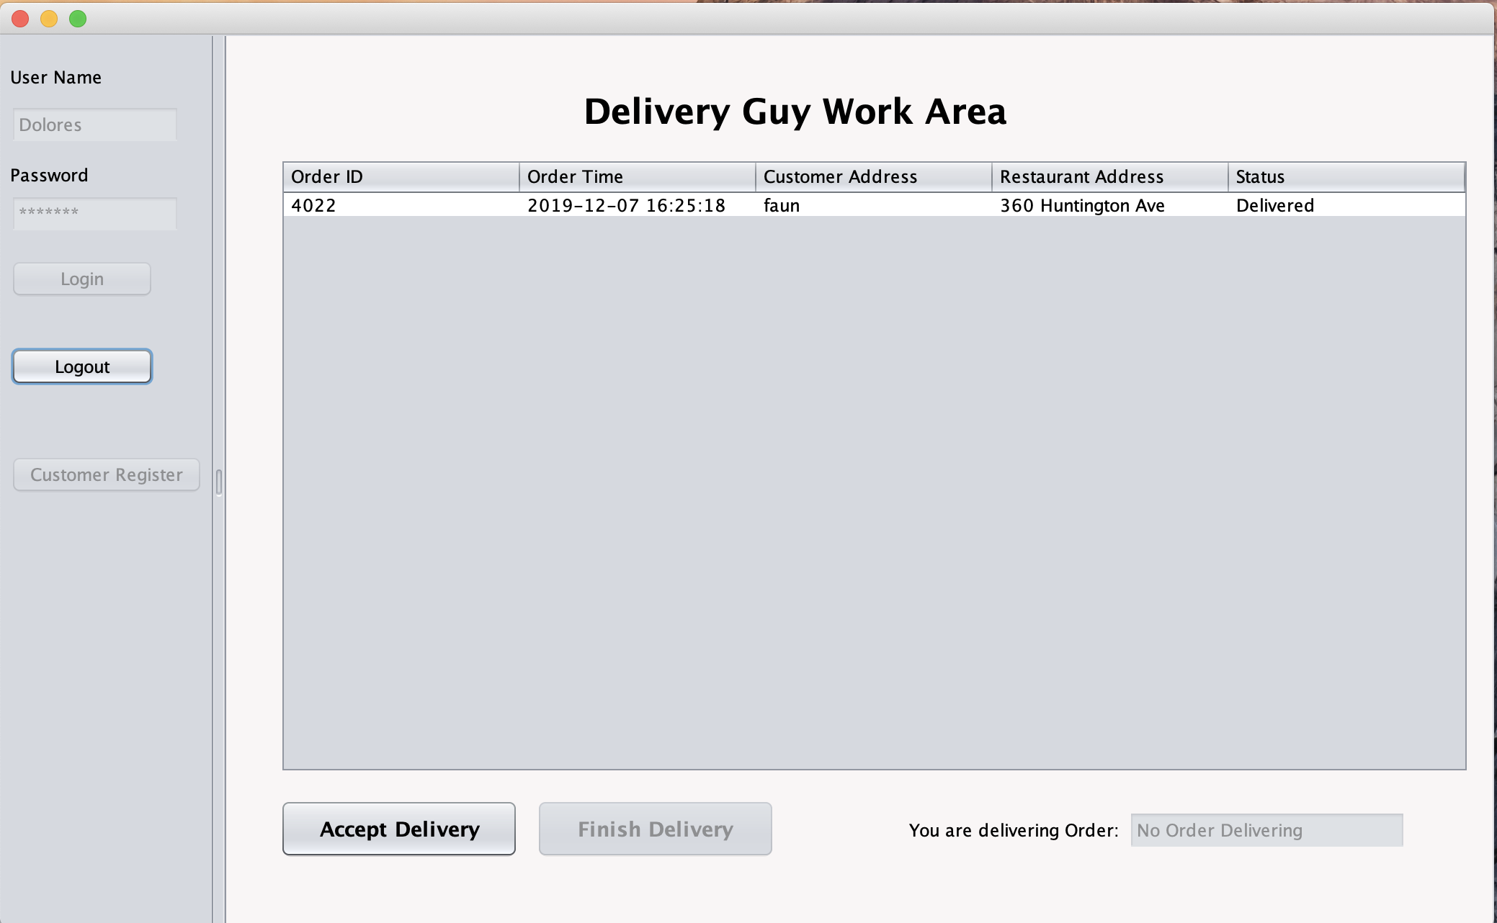

Slide 55
Customer
Create an account to login;
See the detail of the food and make the order
View all the details of the order;

Slide 56
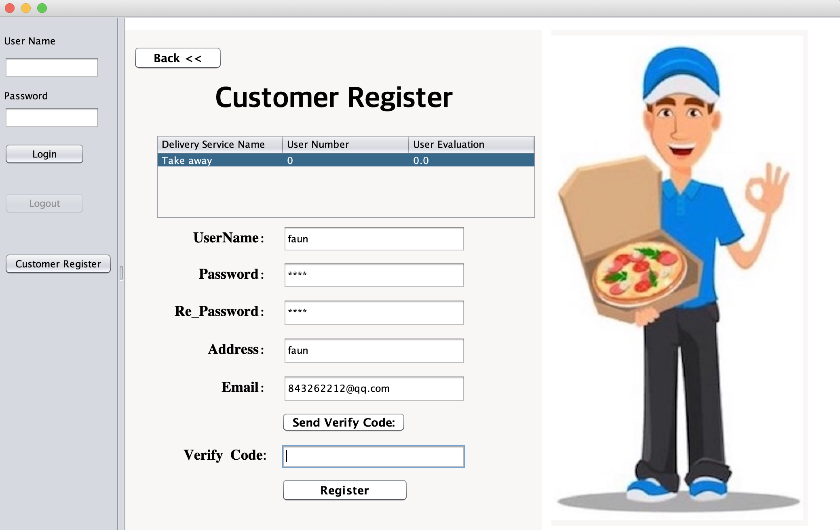

Slide 57


Slide 58
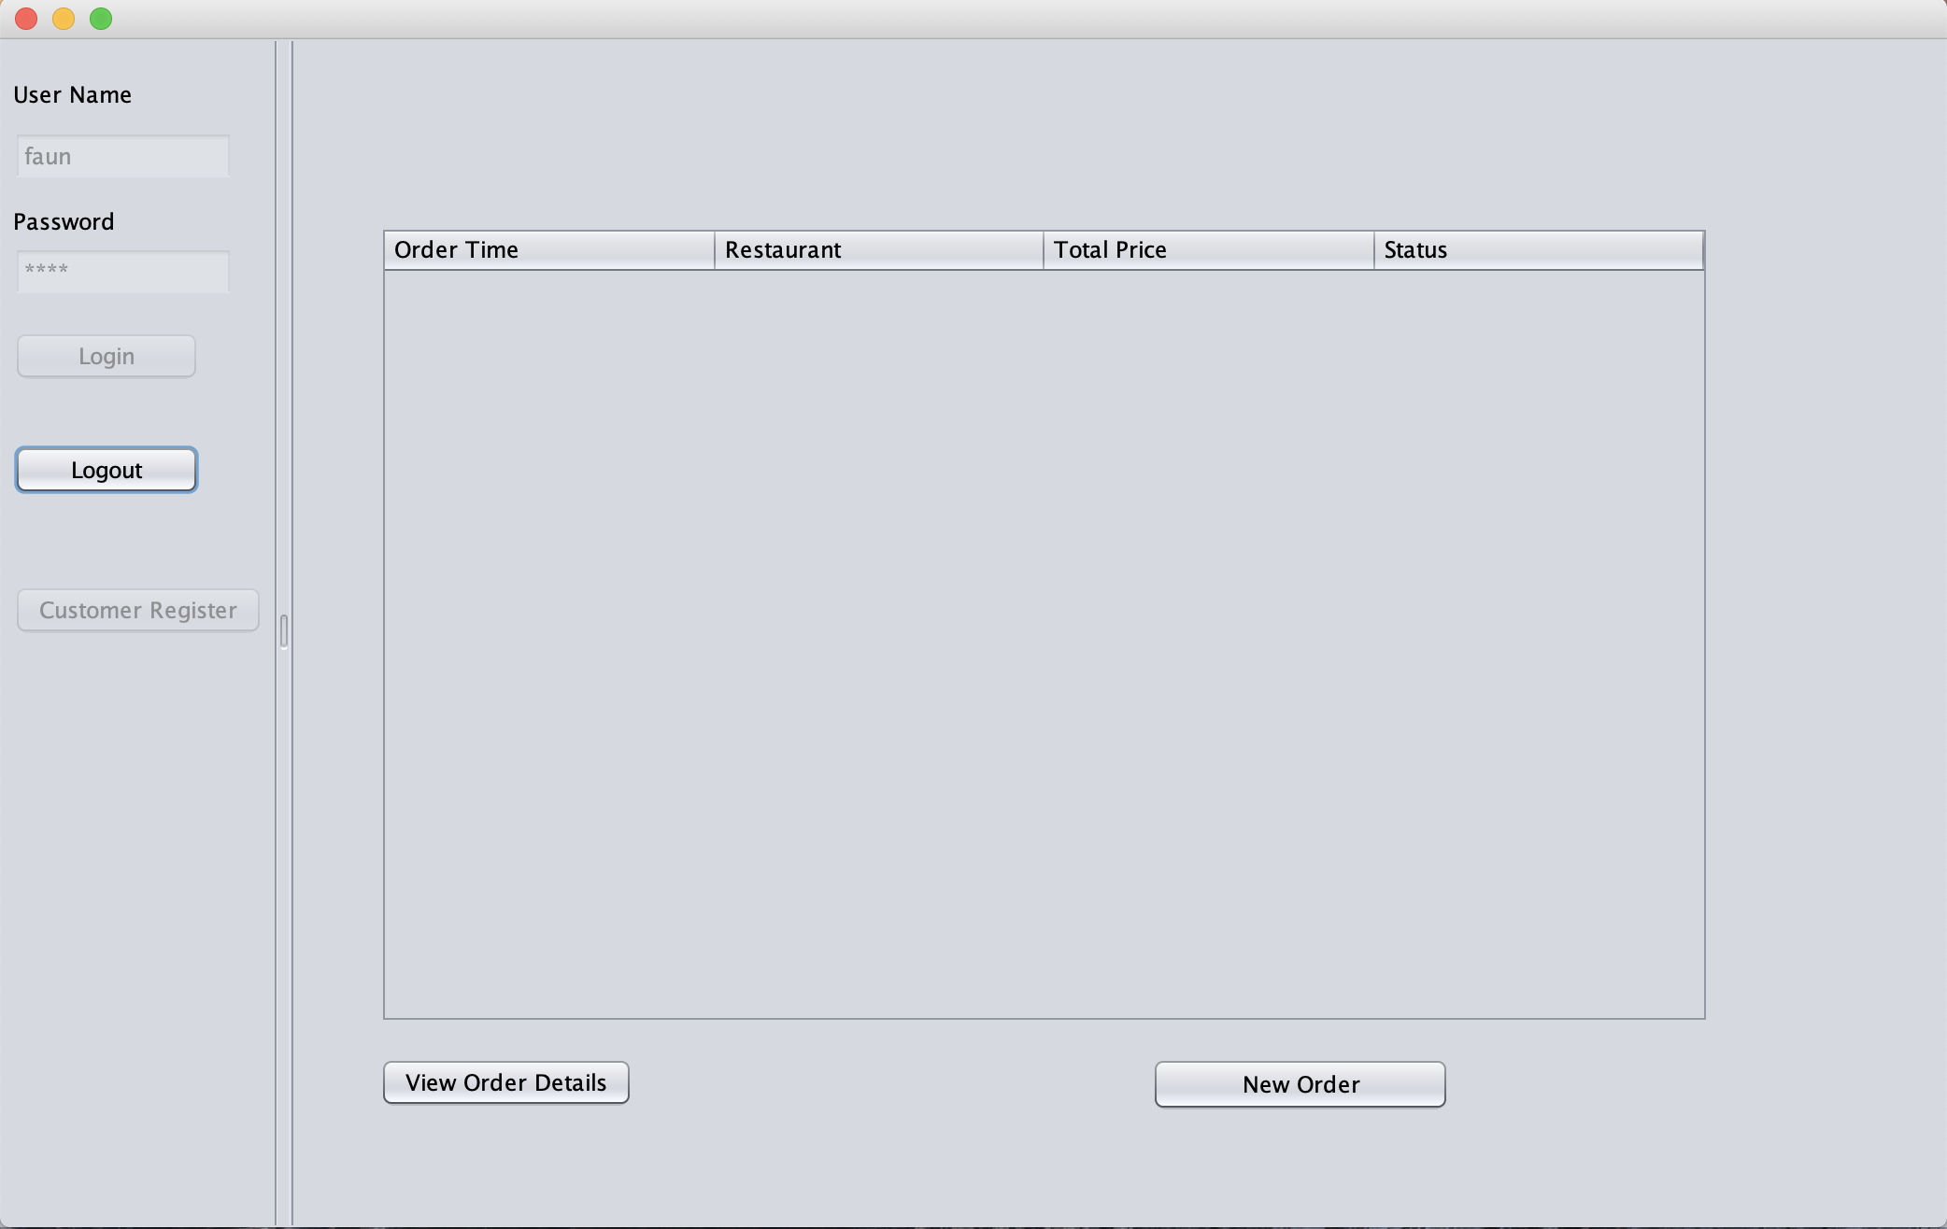

Slide 59
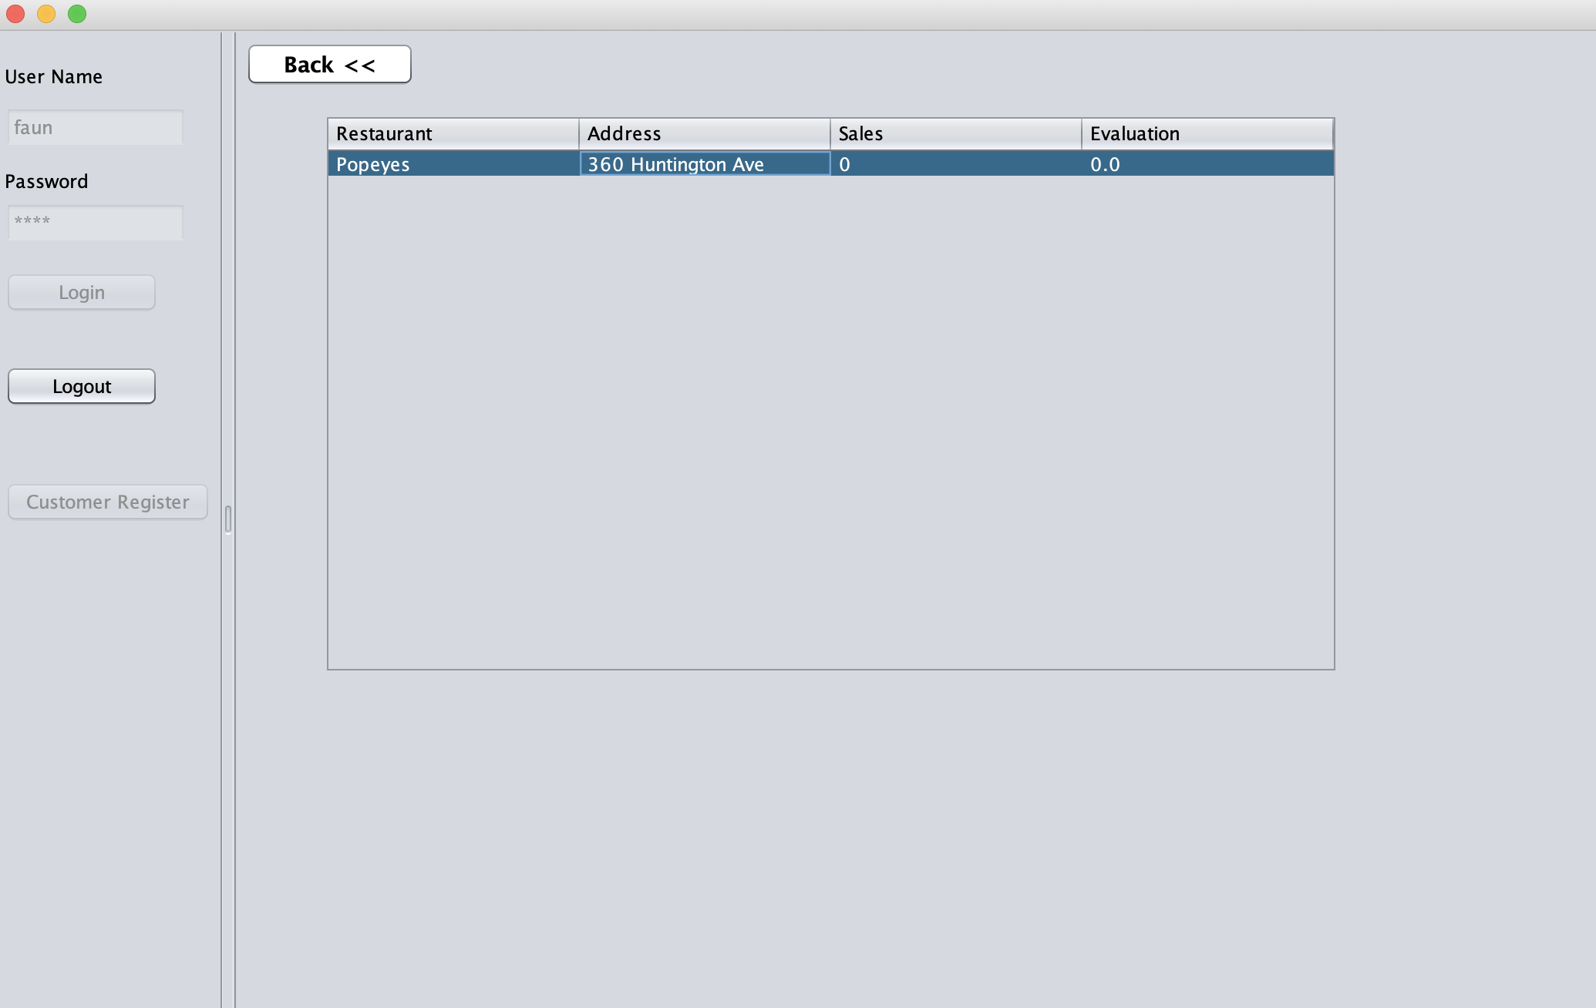

Slide 60
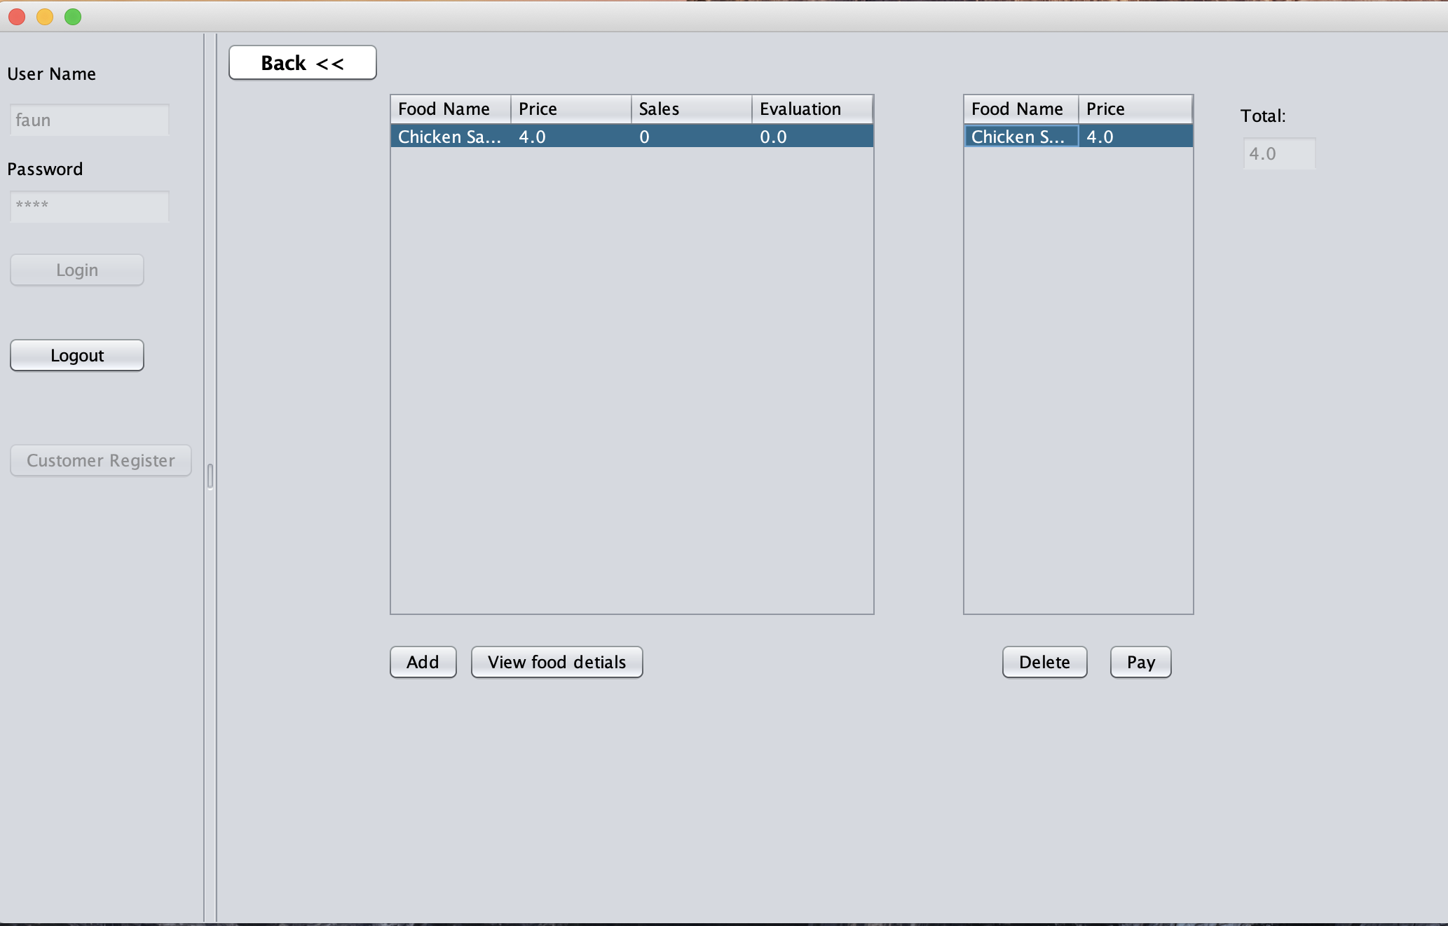

Slide 61
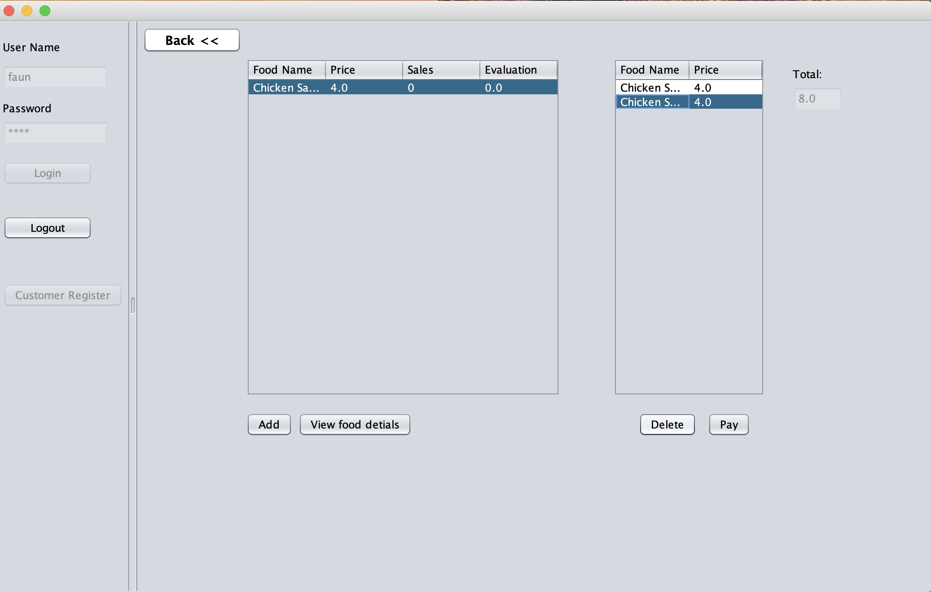

Slide 62
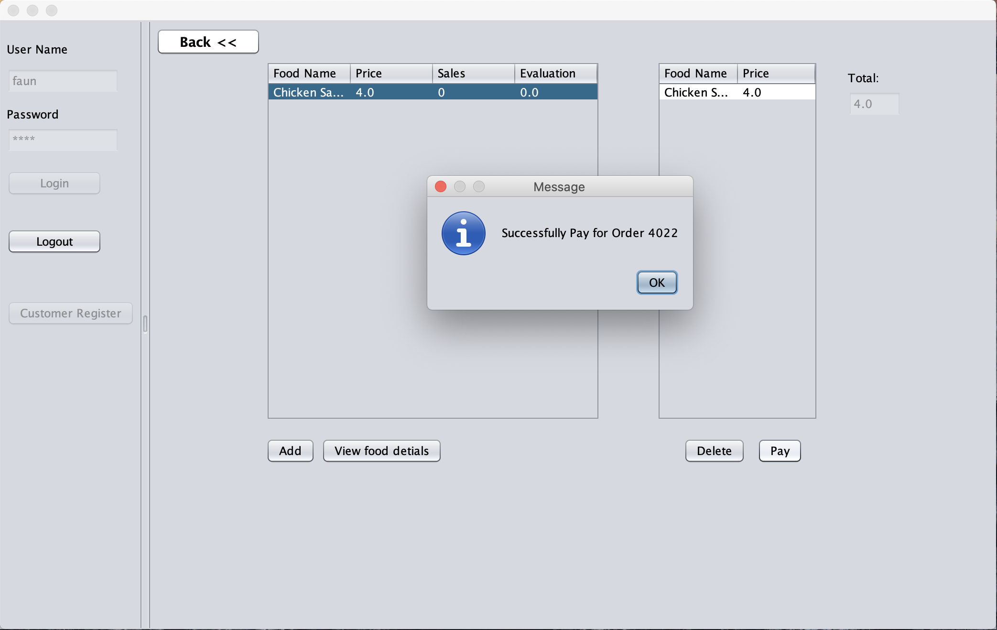

Slide 63
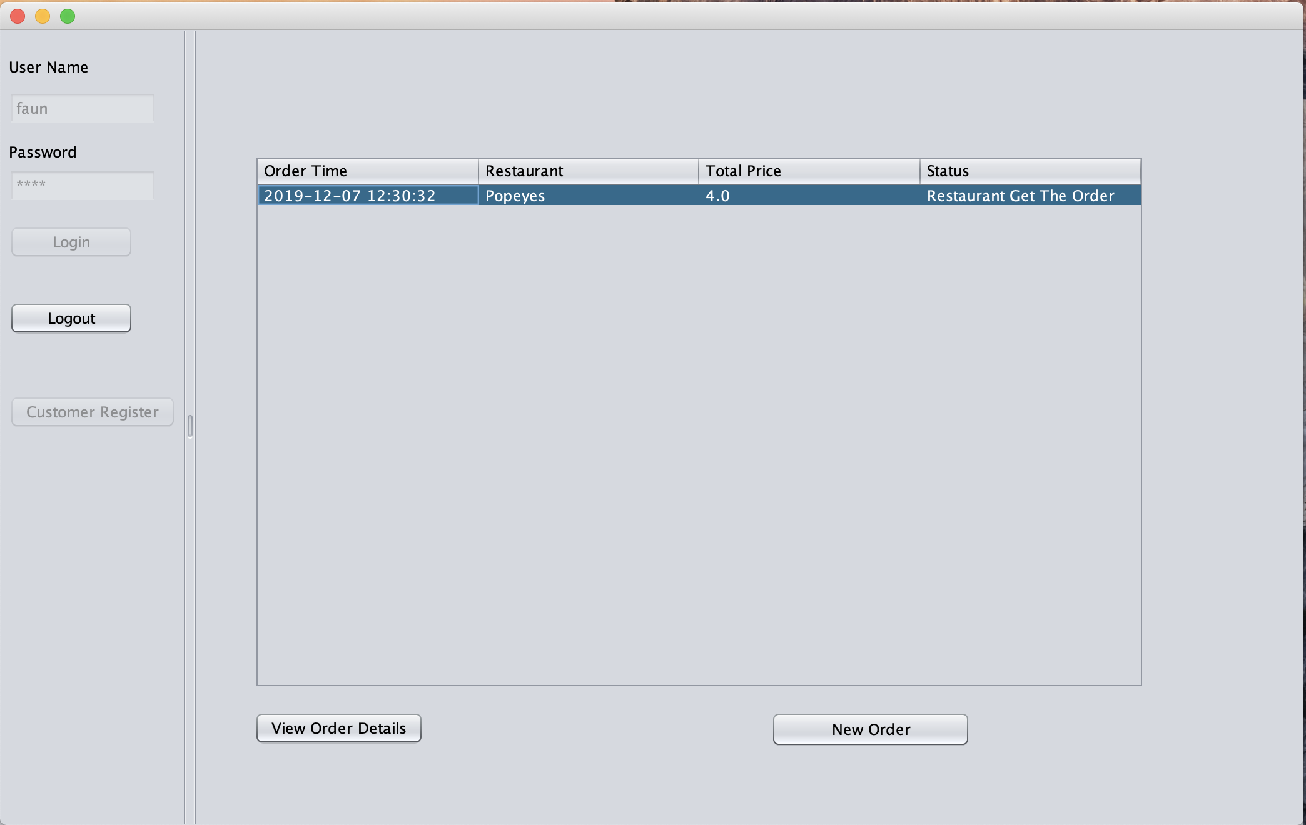

Slide 64
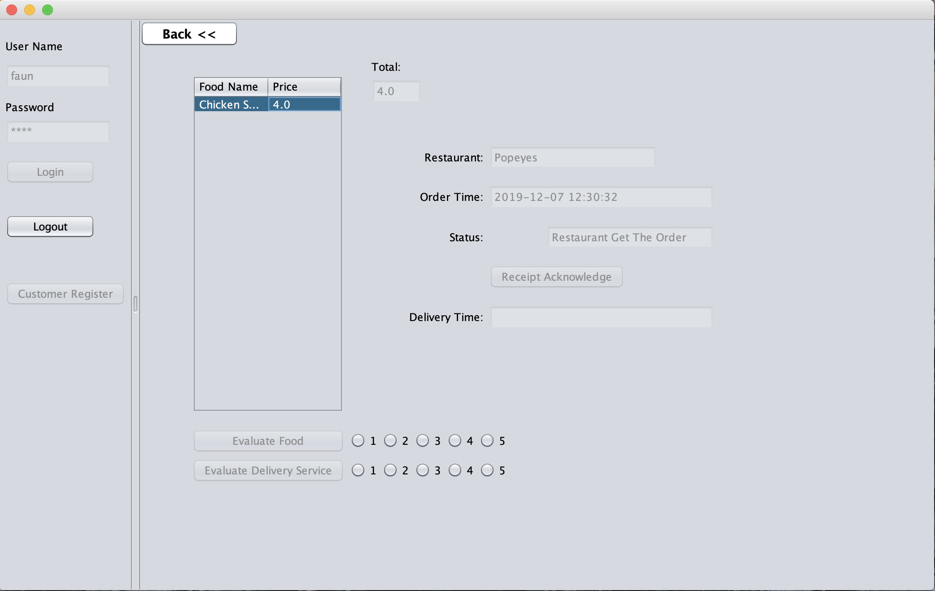

Slide 65
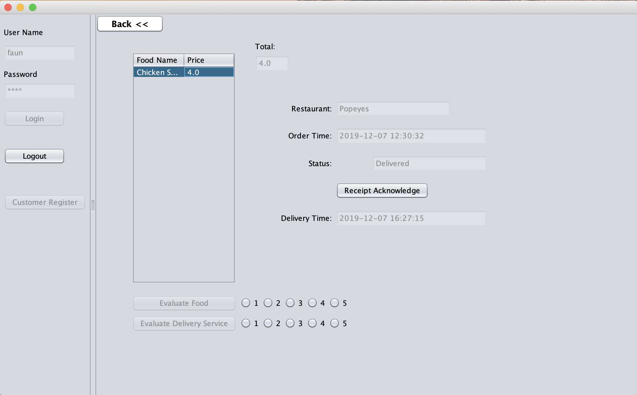

Slide 66


Slide 67


Slide 68

THANKS!

